Slide 1
RWRF 產品資訊
2023/07/27

Slide 2
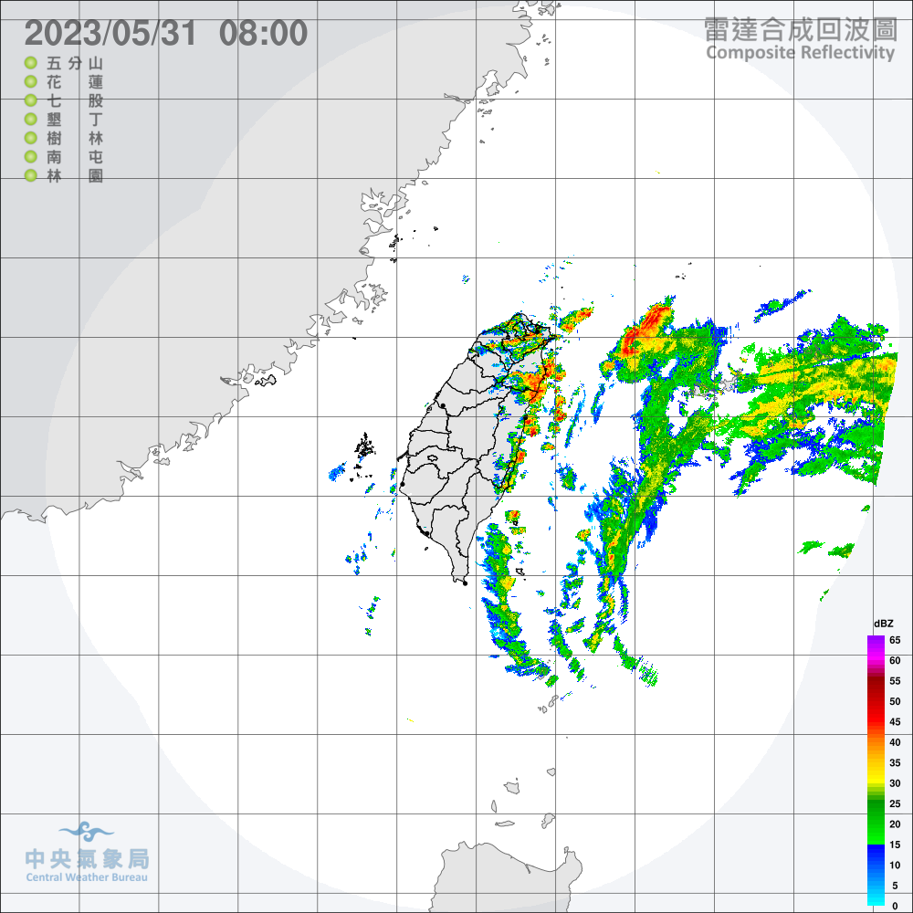
Header
Filename:
wrfout_d01_2023-05-31_00:00:00
Format:
netcdf
Dimensions:
Time = UNLIMITED ; // (1 currently)
DateStrLen = 19 ;
west_east = 450 ;
south_north = 450 ;
bottom_top = 51 ;
bottom_top_stag = 52 ;
soil_layers_stag = 4 ;
west_east_stag = 451 ;
south_north_stag = 451 ;
個案：2023年5月瑪娃颱風

Slide 3
Variables - Grid

Slide 4
Variables (Grid)
char Times(Time, DateStrLen) ;
float XLAT(Time, south_north, west_east) ;
XLAT:FieldType = 104 ;
XLAT:MemoryOrder = "XY " ;
XLAT:description = "LATITUDE, SOUTH IS NEGATIVE" ;
XLAT:units = "degree_north" ;
XLAT:stagger = "" ;
XLAT:coordinates = "XLONG XLAT" ;
float XLONG(Time, south_north, west_east) ;
XLONG:FieldType = 104 ;
XLONG:MemoryOrder = "XY " ;
XLONG:description = "LONGITUDE, WEST IS NEGATIVE" ;
XLONG:units = "degree_east" ;
XLONG:stagger = "" ;
XLONG:coordinates = "XLONG XLAT" ;

Slide 5
Variables (Grid)
float XLAT_U(Time, south_north, west_east_stag) ;
XLAT_U:FieldType = 104 ;
XLAT_U:MemoryOrder = "XY " ;
XLAT_U:description = "LATITUDE, SOUTH IS NEGATIVE" ;
XLAT_U:units = "degree_north" ;
XLAT_U:stagger = "X" ;
XLAT_U:coordinates = "XLONG_U XLAT_U" ;
float XLONG_U(Time, south_north, west_east_stag) ;
XLONG_U:FieldType = 104 ;
XLONG_U:MemoryOrder = "XY " ;
XLONG_U:description = "LONGITUDE, WEST IS NEGATIVE" ;
XLONG_U:units = "degree_east" ;
XLONG_U:stagger = "X" ;
XLONG_U:coordinates = "XLONG_U XLAT_U" ;

Slide 6
Variables (Grid)
float XLAT_V(Time, south_north_stag, west_east) ;
XLAT_V:FieldType = 104 ;
XLAT_V:MemoryOrder = "XY " ;
XLAT_V:description = "LATITUDE, SOUTH IS NEGATIVE" ;
XLAT_V:units = "degree_north" ;
XLAT_V:stagger = "Y" ;
XLAT_V:coordinates = "XLONG_V XLAT_V" ;
float XLONG_V(Time, south_north_stag, west_east) ;
XLONG_V:FieldType = 104 ;
XLONG_V:MemoryOrder = "XY " ;
XLONG_V:description = "LONGITUDE, WEST IS NEGATIVE" ;
XLONG_V:units = "degree_east" ;
XLONG_V:stagger = "Y" ;
XLONG_V:coordinates = "XLONG_V XLAT_V" ;

Slide 7
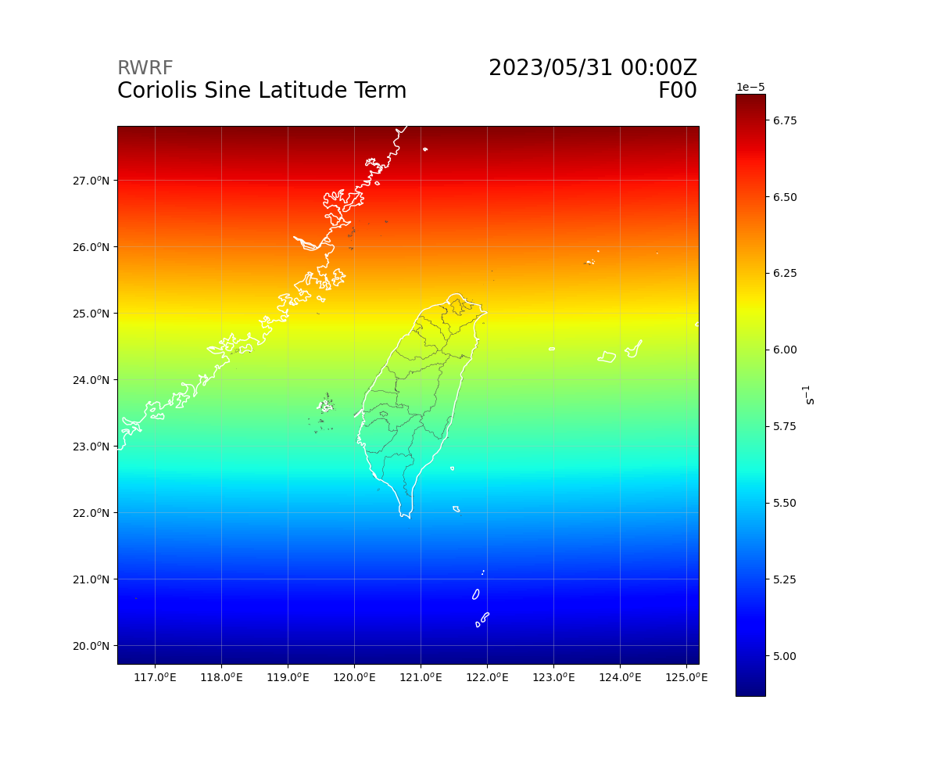
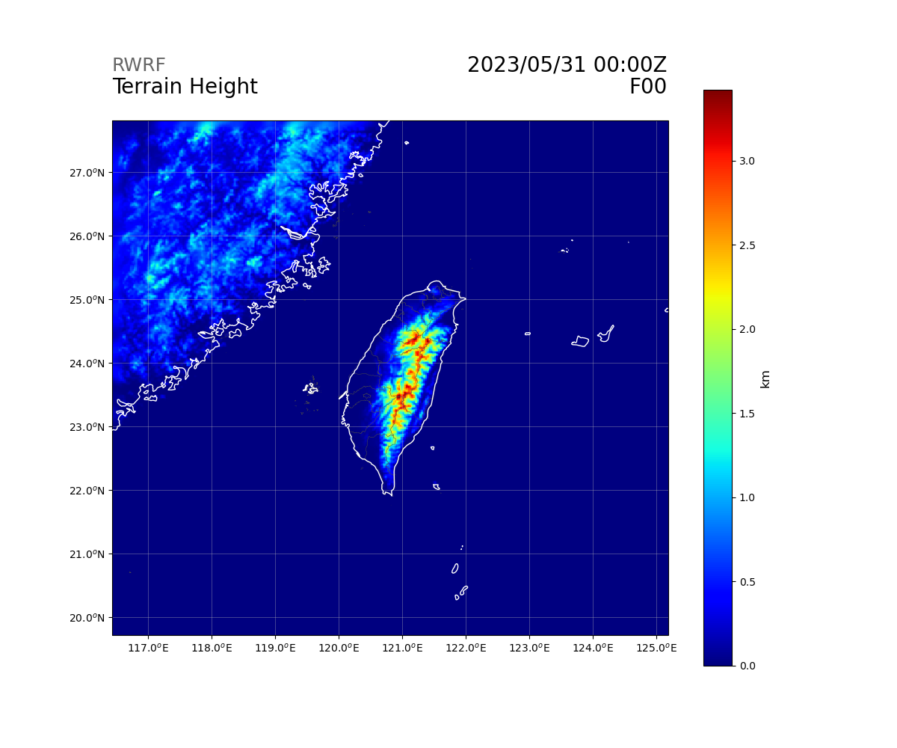
Variables (Grid)
float F(Time, south_north, west_east) ;
F:FieldType = 104 ;
F:MemoryOrder = "XY " ;
F:description = "Coriolis sine latitude term" ;
F:units = "s-1" ;
F:stagger = "" ;
F:coordinates = "XLONG XLAT XTIME" ;
float HGT(Time, south_north, west_east) ;
HGT:FieldType = 104 ;
HGT:MemoryOrder = "XY " ;
HGT:description = "Terrain Height" ;
HGT:units = "m" ;
HGT:stagger = "" ;
HGT:coordinates = "XLONG XLAT XTIME" ;

Slide 8
Variables (Grid)
0.99825, 0.99425, 0.98925, 0.98300004, 0.97525, 0.966, 0.95525, 0.943, 0.92904997, 0.9133, 0.896, 0.87725, 0.857, 0.83525, 0.81175, 0.78625, 0.759, 0.73, 0.699, 0.6665, 0.633, 0.5985, 0.5635, 0.52875, 0.49449998, 0.461, 0.42874998, 0.39824998, 0.36965, 0.34285, 0.3178, 0.2944, 0.27255, 0.2521, 0.23285, 0.21465, 0.19749999, 0.18135, 0.16600001, 0.15134999, 0.1374, 0.12415001, 0.1116, 0.09975, 0.0884, 0.07735001, 0.06645, 0.0555, 0.044, 0.0295, 0.0105
float ZNU(Time, bottom_top) ;
ZNU:FieldType = 104 ;
ZNU:MemoryOrder = "Z " ;
ZNU:description = "eta values on half (mass) levels" ;
ZNU:units = "" ;
ZNU:stagger = "" ;
float ZNW(Time, bottom_top_stag) ;
ZNW:FieldType = 104 ;
ZNW:MemoryOrder = "Z " ;
ZNW:description = "eta values on full (w) levels" ;
ZNW:units = "" ;
ZNW:stagger = "Z" ;
1, 0.9965, 0.992, 0.9865, 0.9795, 0.971, 0.961, 0.9495, 0.9365, 0.9216, 0.905, 0.887, 0.8675, 0.8465, 0.824, 0.7995, 0.773, 0.745, 0.715, 0.683, 0.65, 0.616, 0.581, 0.546, 0.5115, 0.4775, 0.4445, 0.413, 0.3835, 0.3558, 0.3299, 0.3057, 0.2831, 0.262, 0.2422, 0.2235, 0.2058, 0.1892, 0.1735, 0.1585, 0.1442, 0.1306, 0.1177, 0.1055, 0.094, 0.0828, 0.0719, 0.061, 0.05, 0.038, 0.021, 0

Slide 9
Variables (Grid)
float DN(Time, bottom_top) ;
DN:FieldType = 104 ;
DN:MemoryOrder = "Z " ;
DN:description = "d(eta) values between half (mass) levels" ;
DN:units = "" ;
DN:stagger = "" ;
float DNW(Time, bottom_top) ;
DNW:FieldType = 104 ;
DNW:MemoryOrder = "Z " ;
DNW:description = "d(eta) values between full (w) levels" ;
DNW:units = "" ;
DNW:stagger = "" ;

Slide 10
Variables (Grid)
float RDN(Time, bottom_top) ;
RDN:FieldType = 104 ;
RDN:MemoryOrder = "Z " ;
RDN:description = "inverse d(eta) values between half (mass) levels" ;
RDN:units = "" ;
RDN:stagger = "" ;
float RDNW(Time, bottom_top) ;
RDNW:FieldType = 104 ;
RDNW:MemoryOrder = "Z " ;
RDNW:description = "inverse d(eta) values between full (w) levels" ;
RDNW:units = "" ;
RDNW:stagger = "" ;

Slide 11
Variables (Grid)
float FNM(Time, bottom_top) ;
FNM:FieldType = 104 ;
FNM:MemoryOrder = "Z " ;
FNM:description = "upper weight for vertical stretching" ;
FNM:units = "" ;
FNM:stagger = "" ;
float FNP(Time, bottom_top) ;
FNP:FieldType = 104 ;
FNP:MemoryOrder = "Z " ;
FNP:description = "lower weight for vertical stretching" ;
FNP:units = "" ;
FNP:stagger = "" ;

Slide 12
Variables (Grid)
float RDX(Time) ;
RDX:FieldType = 104 ;
RDX:MemoryOrder = "0 " ;
RDX:description = "INVERSE X GRID LENGTH" ;
RDX:units = "" ;
RDX:stagger = "" ;
float RDY(Time) ;
RDY:FieldType = 104 ;
RDY:MemoryOrder = "0 " ;
RDY:description = "INVERSE Y GRID LENGTH" ;
RDY:units = "" ;
RDY:stagger = "" ;

Slide 13
Variables (Grid)
float RESM(Time) ;
RESM:FieldType = 104 ;
RESM:MemoryOrder = "0 " ;
RESM:description = "TIME WEIGHT CONSTANT FOR SMALL STEPS" ;
RESM:units = "" ;
RESM:stagger = "" ;
float ZETATOP(Time) ;
ZETATOP:FieldType = 104 ;
ZETATOP:MemoryOrder = "0 " ;
ZETATOP:description = "ZETA AT MODEL TOP" ;
ZETATOP:units = "" ;
ZETATOP:stagger = "" ;

Slide 14
Variables - Ground, Column

Slide 15
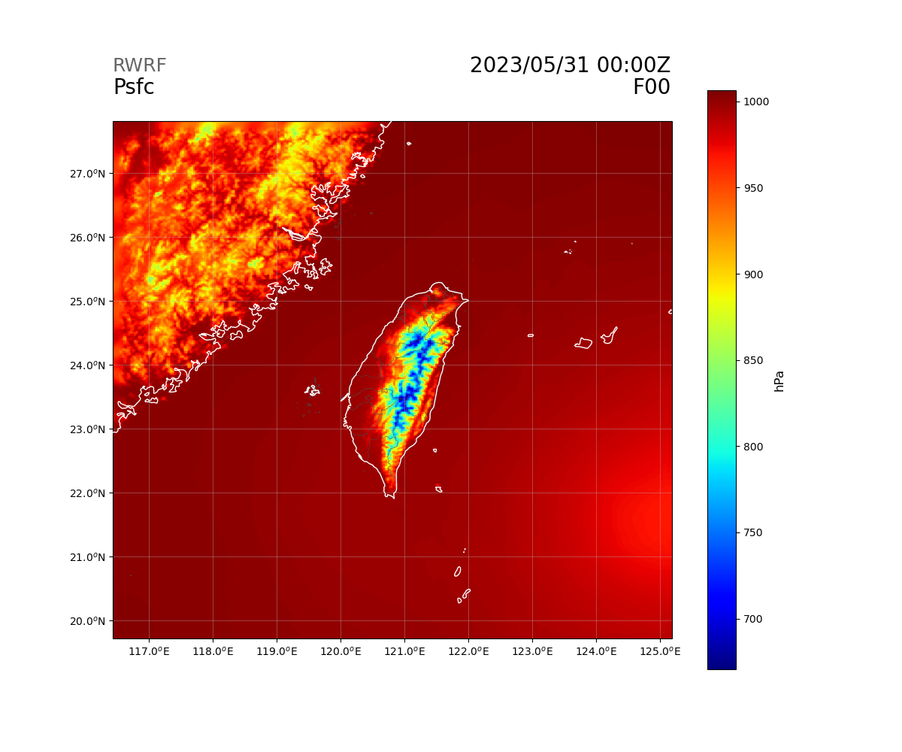
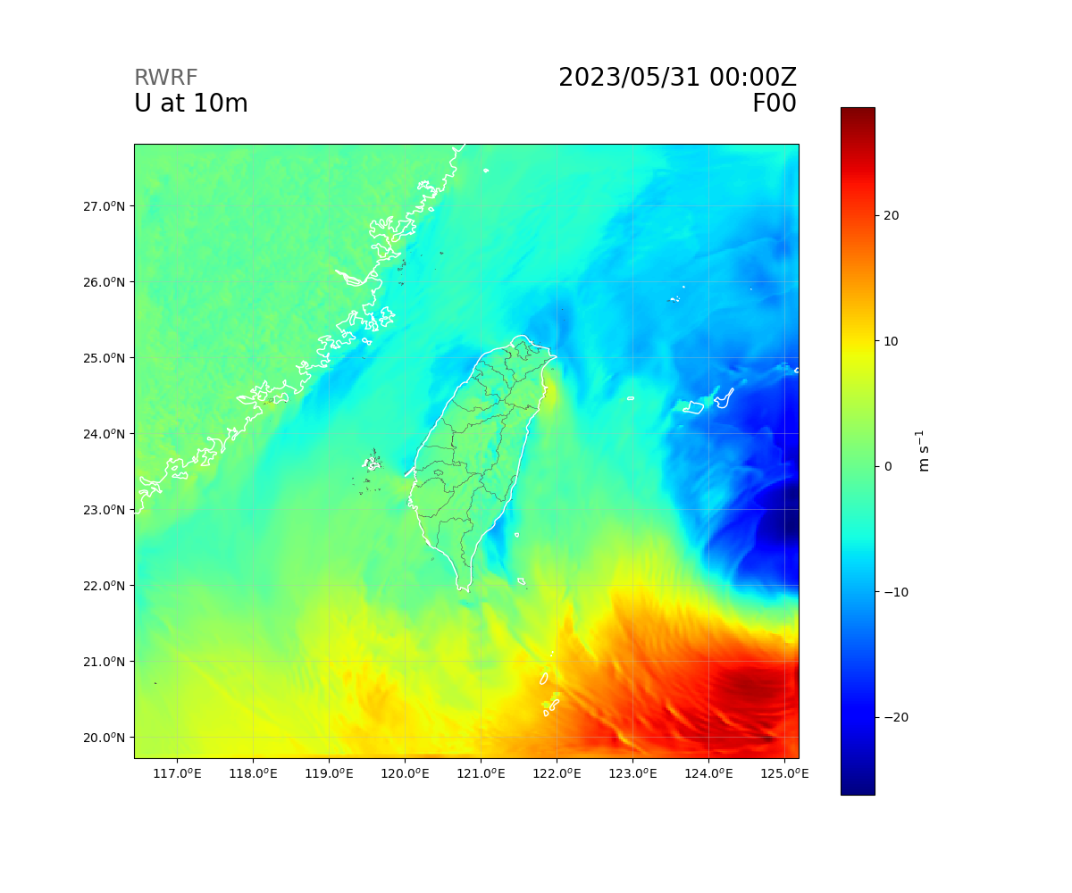
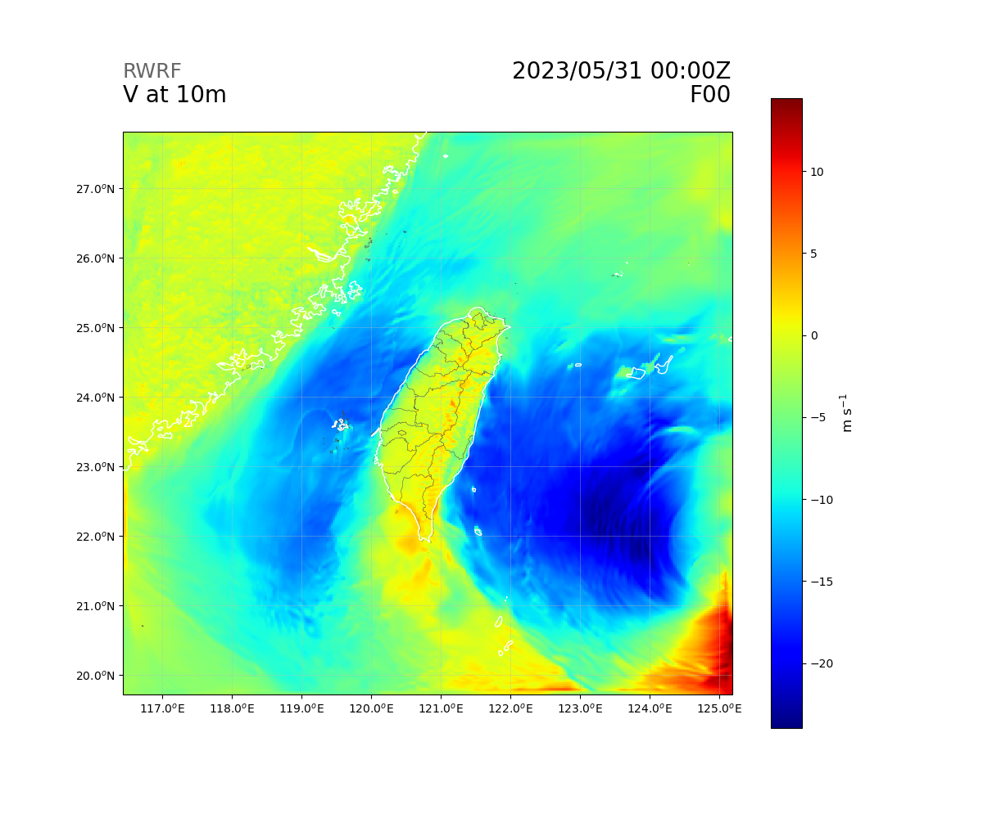
Variables (Ground)
float PSFC(Time, south_north, west_east) ;
PSFC:FieldType = 104 ;
PSFC:MemoryOrder = "XY " ;
PSFC:description = "SFC PRESSURE" ;
PSFC:units = "Pa" ;
PSFC:stagger = "" ;
PSFC:coordinates = "XLONG XLAT XTIME" ;
float U10(Time, south_north, west_east) ;
U10:FieldType = 104 ;
U10:MemoryOrder = "XY " ;
U10:description = "U at 10 M" ;
U10:units = "m s-1" ;
U10:stagger = "" ;
U10:coordinates = "XLONG XLAT XTIME" ;
float V10(Time, south_north, west_east) ;
V10:FieldType = 104 ;
V10:MemoryOrder = "XY " ;
V10:description = "V at 10 M" ;
V10:units = "m s-1" ;
V10:stagger = "" ;
V10:coordinates = "XLONG XLAT XTIME" ;

Slide 16
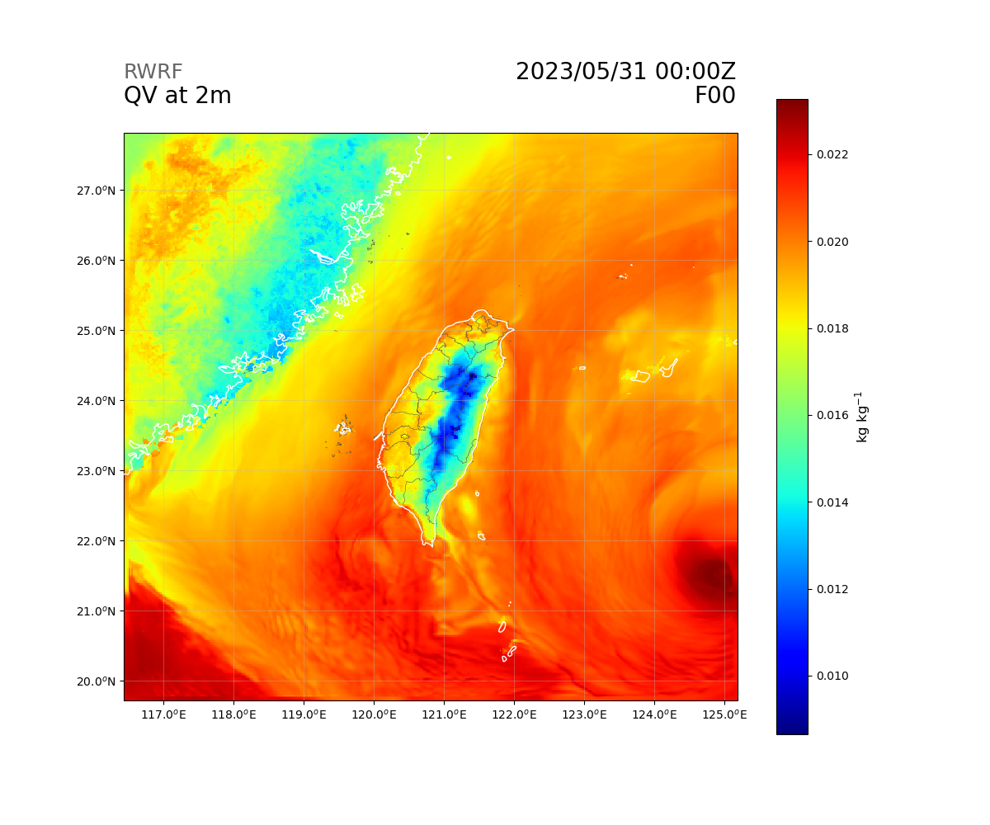
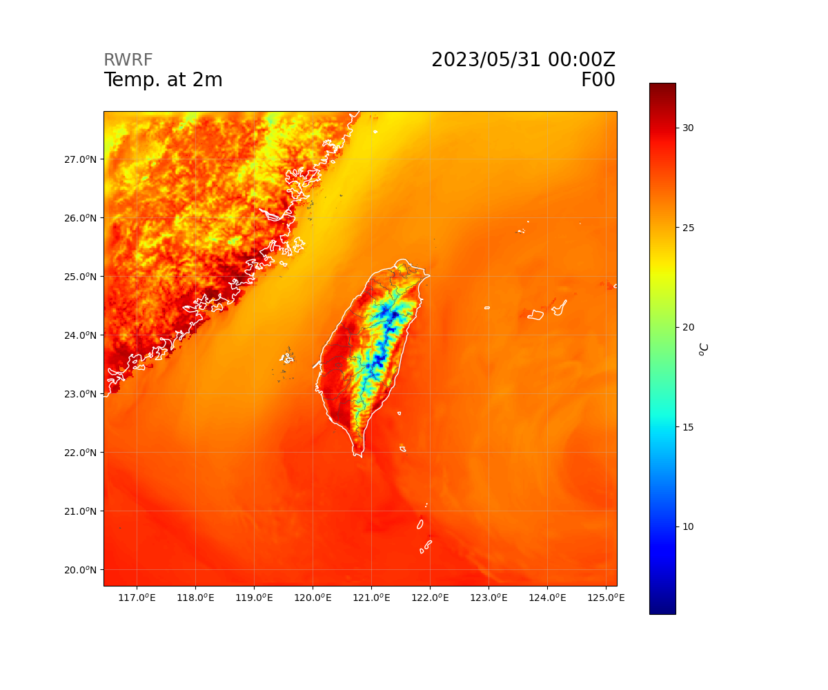
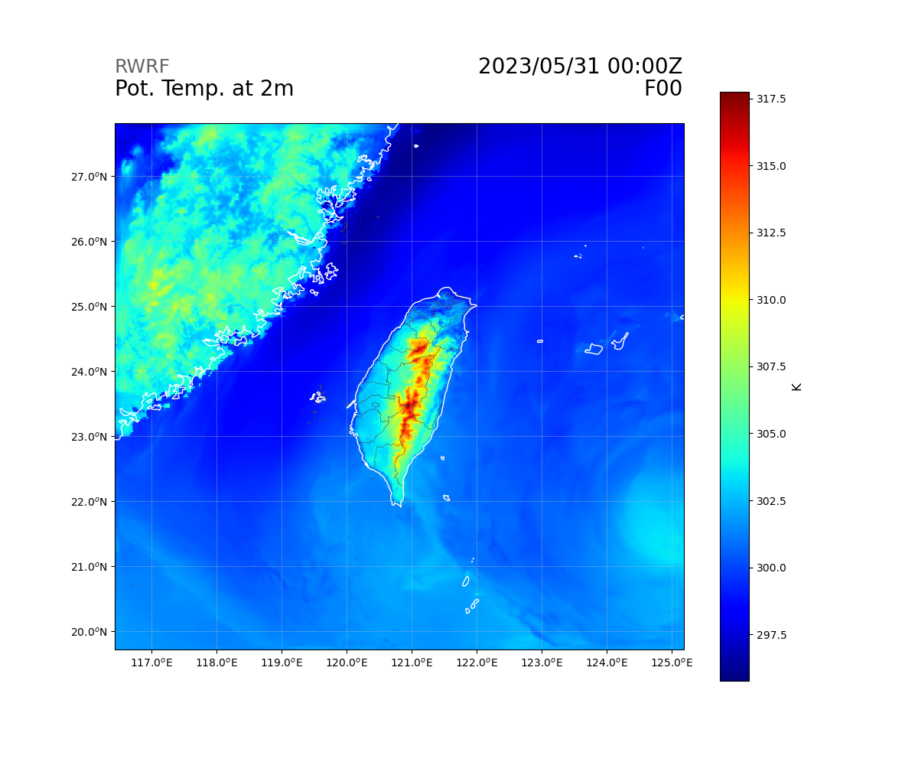
Variables (Ground)
float Q2(Time, south_north, west_east) ;
Q2:FieldType = 104 ;
Q2:MemoryOrder = "XY " ;
Q2:description = "QV at 2 M" ;
Q2:units = "kg kg-1" ;
Q2:stagger = "" ;
Q2:coordinates = "XLONG XLAT XTIME" ;
float T2(Time, south_north, west_east) ;
T2:FieldType = 104 ;
T2:MemoryOrder = "XY " ;
T2:description = "TEMP at 2 M" ;
T2:units = "K" ;
T2:stagger = "" ;
T2:coordinates = "XLONG XLAT XTIME" ;
float TH2(Time, south_north, west_east) ;
TH2:FieldType = 104 ;
TH2:MemoryOrder = "XY " ;
TH2:description = "POT TEMP at 2 M" ;
TH2:units = "K" ;
TH2:stagger = "" ;
TH2:coordinates = "XLONG XLAT XTIME" ;

Slide 17
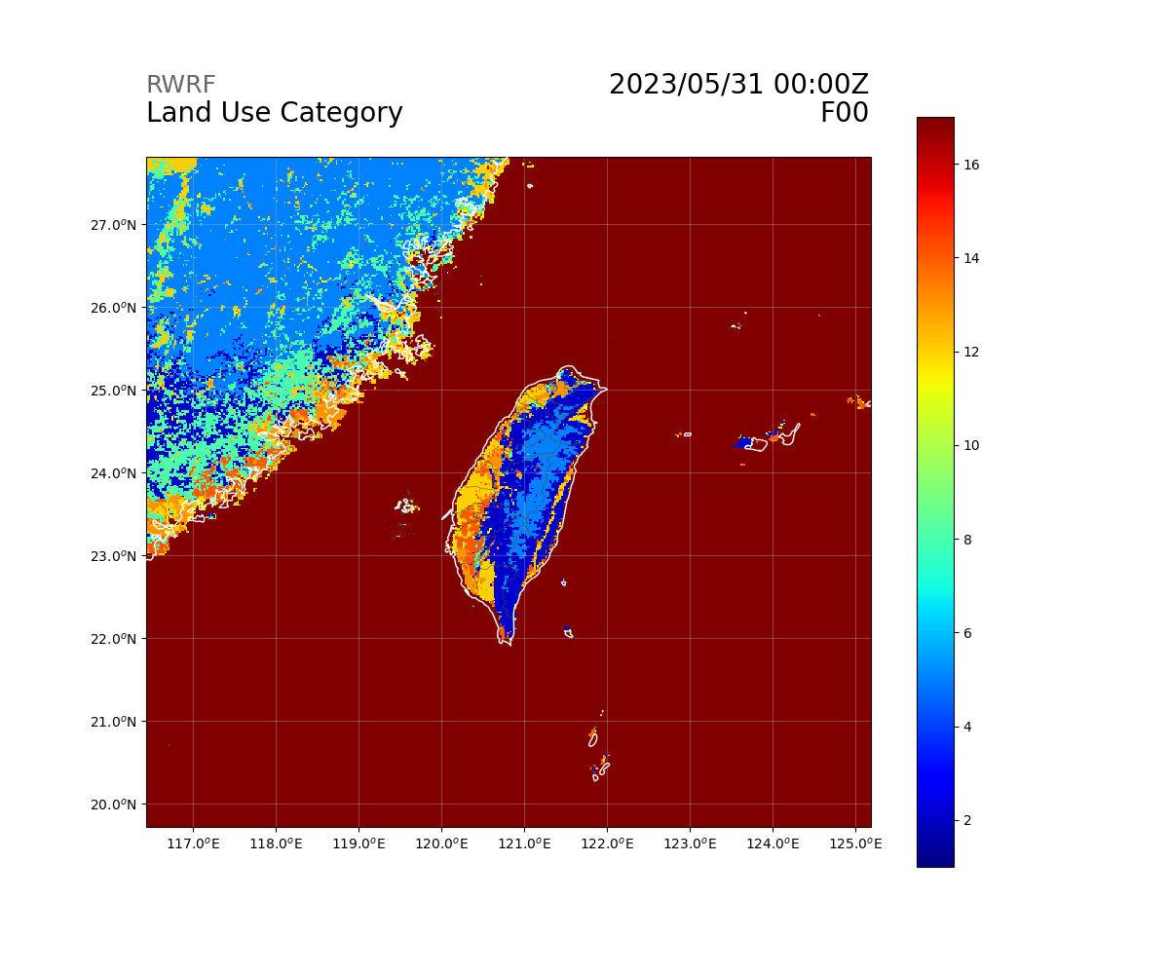
Variables (Ground)
float LU_INDEX(Time, south_north, west_east) ;
LU_INDEX:FieldType = 104 ;
LU_INDEX:MemoryOrder = "XY " ;
LU_INDEX:description = "LAND USE CATEGORY" ;
LU_INDEX:units = "" ;
LU_INDEX:stagger = "" ;
LU_INDEX:coordinates = "XLONG XLAT XTIME" ;
float VAR_SSO(Time, south_north, west_east) ;
VAR_SSO:FieldType = 104 ;
VAR_SSO:MemoryOrder = "XY " ;
VAR_SSO:description = "variance of subgrid-scale orography" ;
VAR_SSO:units = "m2" ;
VAR_SSO:stagger = "" ;
VAR_SSO:coordinates = "XLONG XLAT XTIME" ;
float NEST_POS(Time, south_north, west_east) ;
NEST_POS:FieldType = 104 ;
NEST_POS:MemoryOrder = "XY " ;
NEST_POS:description = "-" ;
NEST_POS:units = "-" ;
NEST_POS:stagger = "" ;
NEST_POS:coordinates = "XLONG XLAT XTIME" ;

Slide 18
Variables (Ground)
float SEAICE(Time, south_north, west_east) ;
SEAICE:FieldType = 104 ;
SEAICE:MemoryOrder = "XY " ;
SEAICE:description = "SEA ICE FLAG" ;
SEAICE:units = "" ;
SEAICE:stagger = "" ;
SEAICE:coordinates = "XLONG XLAT XTIME" ;
float XICEM(Time, south_north, west_east) ;
XICEM:FieldType = 104 ;
XICEM:MemoryOrder = "XY " ;
XICEM:description = "SEA ICE FLAG (PREVIOUS STEP)" ;
XICEM:units = "" ;
XICEM:stagger = "" ;
XICEM:coordinates = "XLONG XLAT XTIME" ;

Slide 19
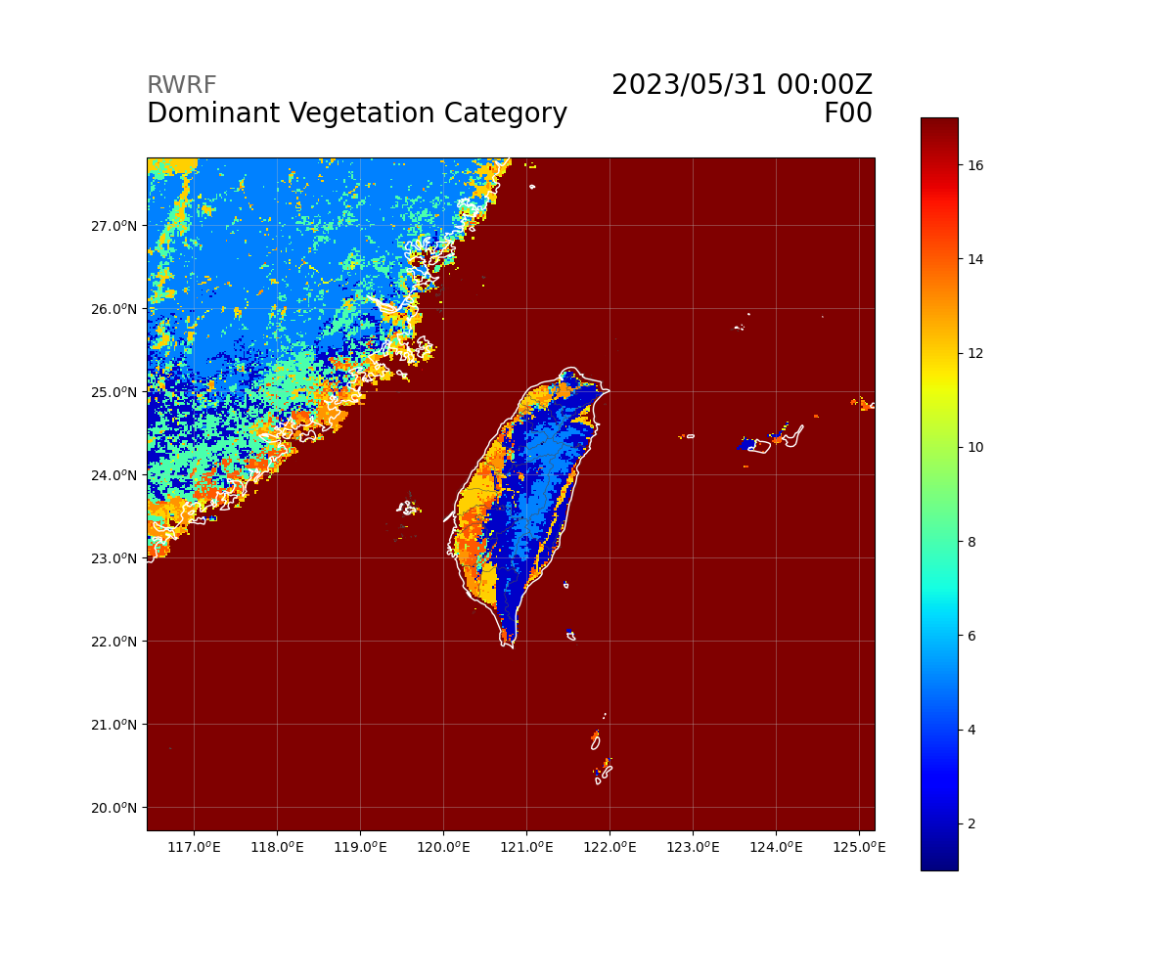
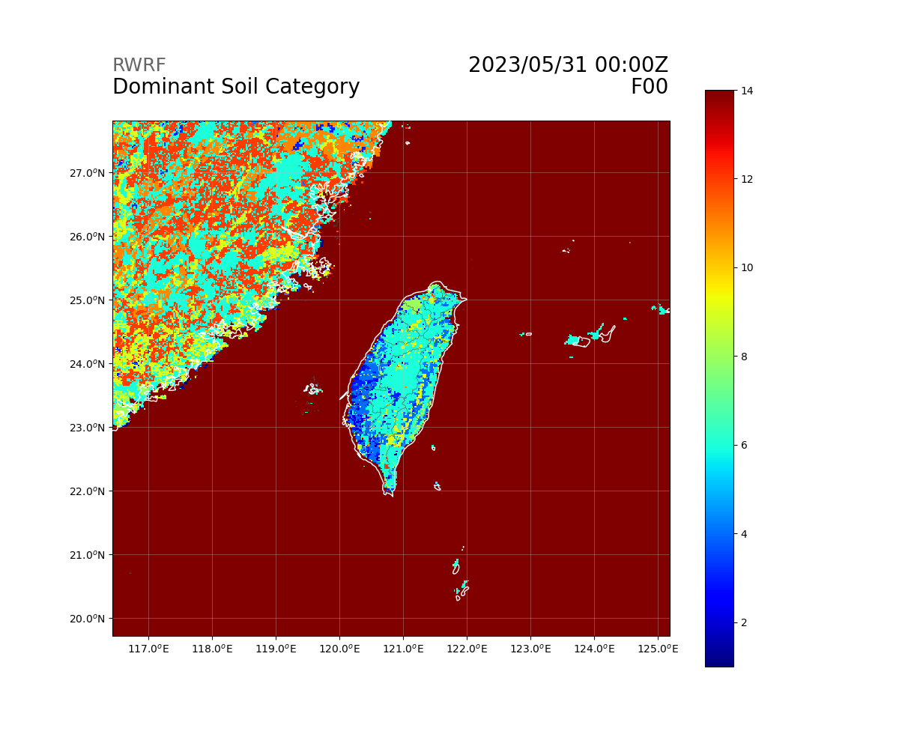
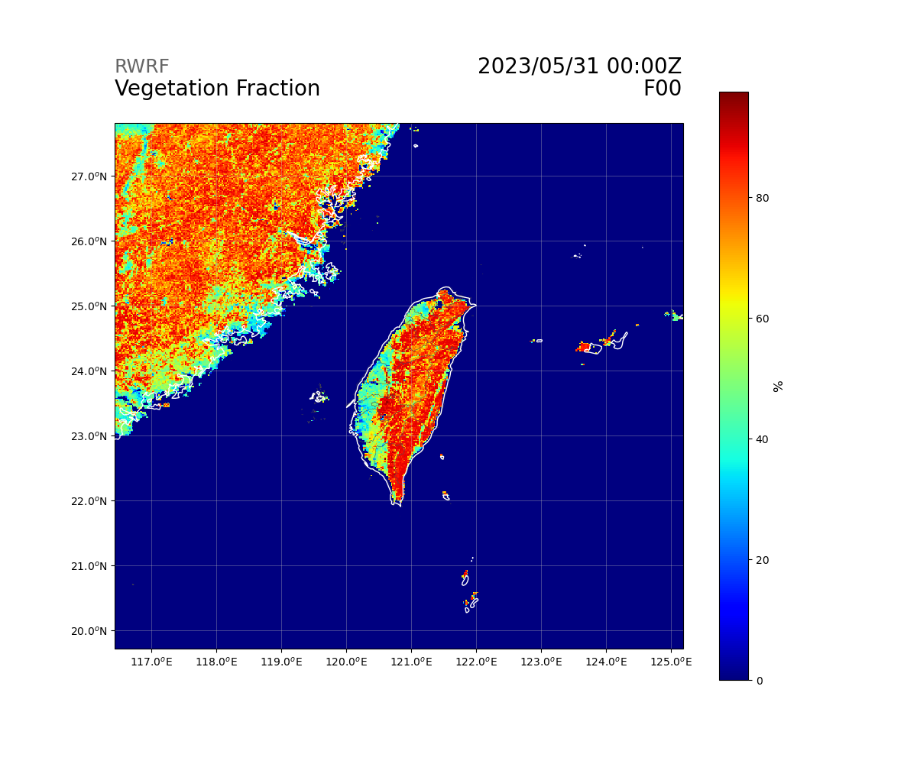
Variables (Ground)
int IVGTYP(Time, south_north, west_east) ;
IVGTYP:FieldType = 106 ;
IVGTYP:MemoryOrder = "XY " ;
IVGTYP:description = "DOMINANT VEGETATION CATEGORY" ;
IVGTYP:units = "" ;
IVGTYP:stagger = "" ;
IVGTYP:coordinates = "XLONG XLAT XTIME" ;
int ISLTYP(Time, south_north, west_east) ;
ISLTYP:FieldType = 106 ;
ISLTYP:MemoryOrder = "XY " ;
ISLTYP:description = "DOMINANT SOIL CATEGORY" ;
ISLTYP:units = "" ;
ISLTYP:stagger = "" ;
ISLTYP:coordinates = "XLONG XLAT XTIME" ;
float VEGFRA(Time, south_north, west_east) ;
VEGFRA:FieldType = 104 ;
VEGFRA:MemoryOrder = "XY " ;
VEGFRA:description = "VEGETATION FRACTION" ;
VEGFRA:units = "" ;
VEGFRA:stagger = "" ;
VEGFRA:coordinates = "XLONG XLAT XTIME" ;

Slide 20
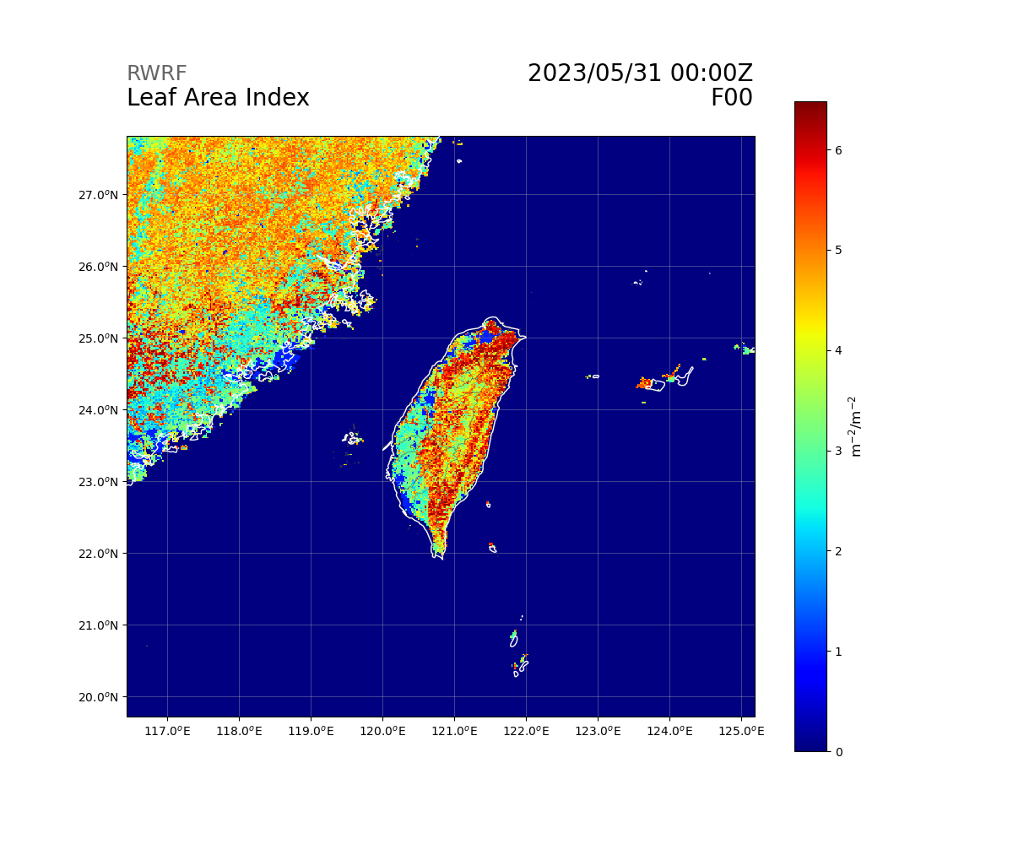
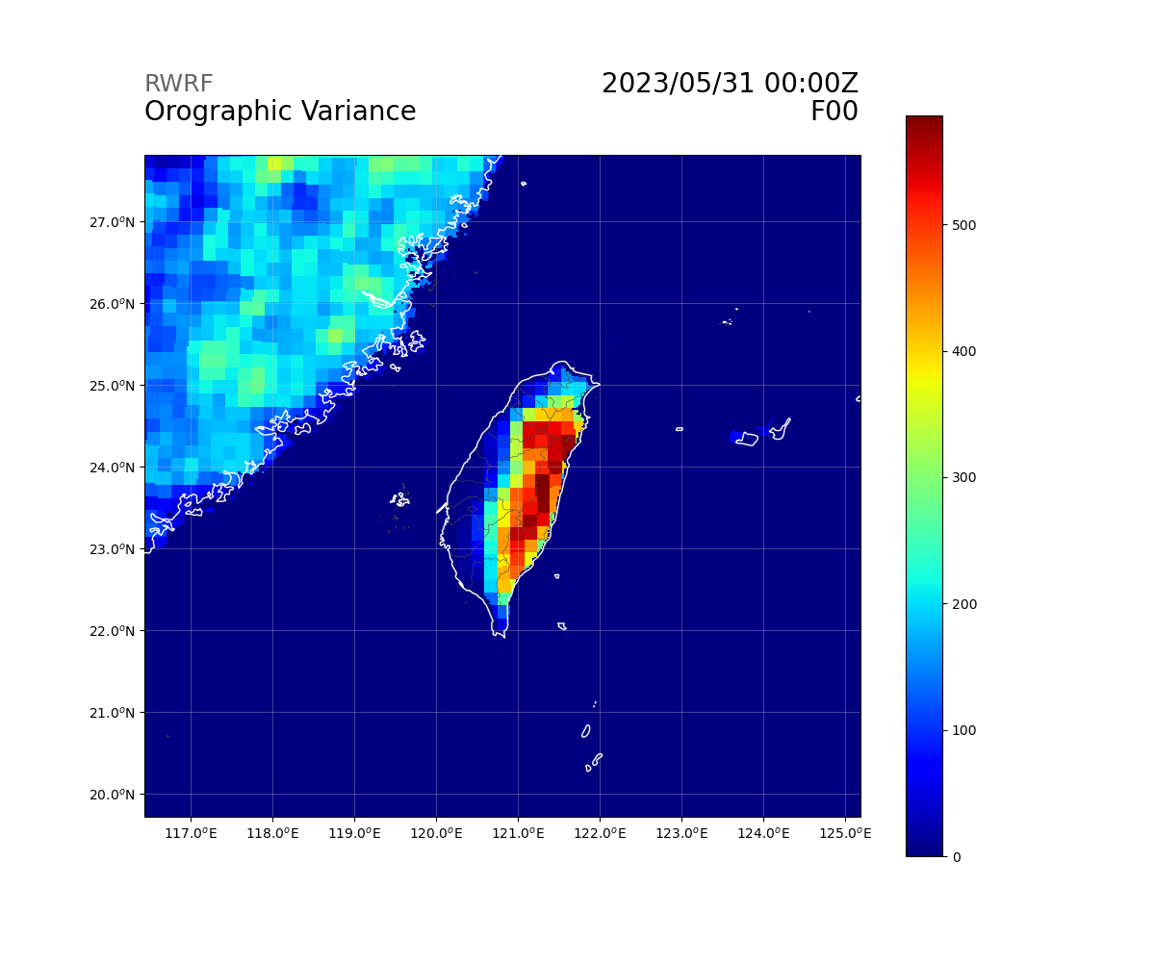
Variables (Ground)
float CANWAT(Time, south_north, west_east) ;
CANWAT:FieldType = 104 ;
CANWAT:MemoryOrder = "XY " ;
CANWAT:description = "CANOPY WATER" ;
CANWAT:units = "kg m-2" ;
CANWAT:stagger = "" ;
CANWAT:coordinates = "XLONG XLAT XTIME" ;
float LAI(Time, south_north, west_east) ;
LAI:FieldType = 104 ;
LAI:MemoryOrder = "XY " ;
LAI:description = "LEAF AREA INDEX" ;
LAI:units = "m-2/m-2" ;
LAI:stagger = "" ;
LAI:coordinates = "XLONG XLAT XTIME" ;
float VAR(Time, south_north, west_east) ;
VAR:FieldType = 104 ;
VAR:MemoryOrder = "XY " ;
VAR:description = "OROGRAPHIC VARIANCE" ;
VAR:units = "" ;
VAR:stagger = "" ;
VAR:coordinates = "XLONG XLAT XTIME" ;

Slide 21
Variables (Map Scale Factor)
float MAPFAC_M(Time, south_north, west_east) ;
MAPFAC_M:FieldType = 104 ;
MAPFAC_M:MemoryOrder = "XY " ;
MAPFAC_M:description = "Map scale factor on mass grid" ;
MAPFAC_M:units = "" ;
MAPFAC_M:stagger = "" ;
MAPFAC_M:coordinates = "XLONG XLAT XTIME" ;
float MAPFAC_U(Time, south_north, west_east_stag) ;
MAPFAC_U:FieldType = 104 ;
MAPFAC_U:MemoryOrder = "XY " ;
MAPFAC_U:description = "Map scale factor on u-grid" ;
MAPFAC_U:units = "" ;
MAPFAC_U:stagger = "X" ;
MAPFAC_U:coordinates = "XLONG_U XLAT_U XTIME" ;
float MAPFAC_V(Time, south_north_stag, west_east) ;
MAPFAC_V:FieldType = 104 ;
MAPFAC_V:MemoryOrder = "XY " ;
MAPFAC_V:description = "Map scale factor on v-grid" ;
MAPFAC_V:units = "" ;
MAPFAC_V:stagger = "Y" ;
MAPFAC_V:coordinates = "XLONG_V XLAT_V XTIME" ;

Slide 22
Variables (Map Scale Factor)
float MAPFAC_MX(Time, south_north, west_east) ;
MAPFAC_MX:FieldType = 104 ;
MAPFAC_MX:MemoryOrder = "XY " ;
MAPFAC_MX:description = "Map scale factor on mass grid, x direction" ;
MAPFAC_MX:units = "" ;
MAPFAC_MX:stagger = "" ;
MAPFAC_MX:coordinates = "XLONG XLAT XTIME" ;
float MAPFAC_MY(Time, south_north, west_east) ;
MAPFAC_MY:FieldType = 104 ;
MAPFAC_MY:MemoryOrder = "XY " ;
MAPFAC_MY:description = "Map scale factor on mass grid, y direction" ;
MAPFAC_MY:units = "" ;
MAPFAC_MY:stagger = "" ;
MAPFAC_MY:coordinates = "XLONG XLAT XTIME" ;

Slide 23
Variables (Map Scale Factor)
float MAPFAC_UX(Time, south_north, west_east_stag) ;
MAPFAC_UX:FieldType = 104 ;
MAPFAC_UX:MemoryOrder = "XY " ;
MAPFAC_UX:description = "Map scale factor on u-grid, x direction" ;
MAPFAC_UX:units = "" ;
MAPFAC_UX:stagger = "X" ;
MAPFAC_UX:coordinates = "XLONG_U XLAT_U XTIME" ;
float MAPFAC_UY(Time, south_north, west_east_stag) ;
MAPFAC_UY:FieldType = 104 ;
MAPFAC_UY:MemoryOrder = "XY " ;
MAPFAC_UY:description = "Map scale factor on u-grid, y direction" ;
MAPFAC_UY:units = "" ;
MAPFAC_UY:stagger = "X" ;
MAPFAC_UY:coordinates = "XLONG_U XLAT_U XTIME" ;

Slide 24
Variables (Map Scale Factor)
float MAPFAC_VX(Time, south_north_stag, west_east) ;
MAPFAC_VX:FieldType = 104 ;
MAPFAC_VX:MemoryOrder = "XY " ;
MAPFAC_VX:description = "Map scale factor on v-grid, x direction" ;
MAPFAC_VX:units = "" ;
MAPFAC_VX:stagger = "Y" ;
MAPFAC_VX:coordinates = "XLONG_V XLAT_V XTIME" ;
float MF_VX_INV(Time, south_north_stag, west_east) ;
MF_VX_INV:FieldType = 104 ;
MF_VX_INV:MemoryOrder = "XY " ;
MF_VX_INV:description = "Inverse map scale factor on v-grid, x direction" ;
MF_VX_INV:units = "" ;
MF_VX_INV:stagger = "Y" ;
MF_VX_INV:coordinates = "XLONG_V XLAT_V XTIME" ;
float MAPFAC_VY(Time, south_north_stag, west_east) ;
MAPFAC_VY:FieldType = 104 ;
MAPFAC_VY:MemoryOrder = "XY " ;
MAPFAC_VY:description = "Map scale factor on v-grid, y direction" ;
MAPFAC_VY:units = "" ;
MAPFAC_VY:stagger = "Y" ;
MAPFAC_VY:coordinates = "XLONG_V XLAT_V XTIME" ;

Slide 25
Variables (Ground)
float RAINC(Time, south_north, west_east) ;
RAINC:FieldType = 104 ;
RAINC:MemoryOrder = "XY " ;
RAINC:description = "ACCUMULATED TOTAL CUMULUS PRECIPITATION" ;
RAINC:units = "mm" ;
RAINC:stagger = "" ;
RAINC:coordinates = "XLONG XLAT XTIME" ;
float RAINSH(Time, south_north, west_east) ;
RAINSH:FieldType = 104 ;
RAINSH:MemoryOrder = "XY " ;
RAINSH:description = "ACCUMULATED SHALLOW CUMULUS PRECIPITATION" ;
RAINSH:units = "mm" ;
RAINSH:stagger = "" ;
RAINSH:coordinates = "XLONG XLAT XTIME" ;
float RAINNC(Time, south_north, west_east) ;
RAINNC:FieldType = 104 ;
RAINNC:MemoryOrder = "XY " ;
RAINNC:description = "ACCUMULATED TOTAL GRID SCALE PRECIPITATION" ;
RAINNC:units = "mm" ;
RAINNC:stagger = "" ;
RAINNC:coordinates = "XLONG XLAT XTIME" ;

Slide 26
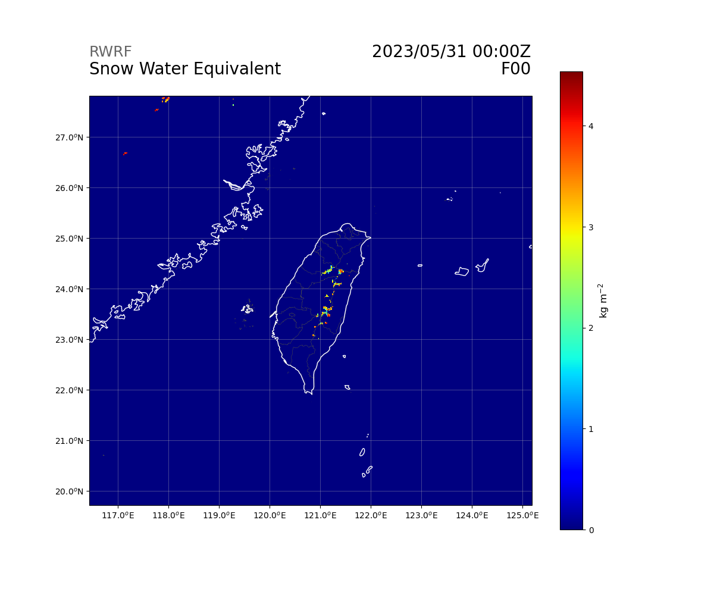

Variables (Ground)
float SNOW(Time, south_north, west_east) ;
SNOW:FieldType = 104 ;
SNOW:MemoryOrder = "XY " ;
SNOW:description = "SNOW WATER EQUIVALENT" ;
SNOW:units = "kg m-2" ;
SNOW:stagger = "" ;
SNOW:coordinates = "XLONG XLAT XTIME" ;
float SNOWH(Time, south_north, west_east) ;
SNOWH:FieldType = 104 ;
SNOWH:MemoryOrder = "XY " ;
SNOWH:description = "PHYSICAL SNOW DEPTH" ;
SNOWH:units = "m" ;
SNOWH:stagger = "" ;
SNOWH:coordinates = "XLONG XLAT XTIME" ;

Slide 27

Variables (Ground)
float SNOWC(Time, south_north, west_east) ;
SNOWC:FieldType = 104 ;
SNOWC:MemoryOrder = "XY " ;
SNOWC:description = "FLAG INDICATING SNOW COVERAGE (1 FOR SNOW COVER)" ;
SNOWC:units = "" ;
SNOWC:stagger = "" ;
SNOWC:coordinates = "XLONG XLAT XTIME" ;
float SR(Time, south_north, west_east) ;
SR:FieldType = 104 ;
SR:MemoryOrder = "XY " ;
SR:description = "fraction of frozen precipitation" ;
SR:units = "-" ;
SR:stagger = "" ;
SR:coordinates = "XLONG XLAT XTIME" ;

Slide 28
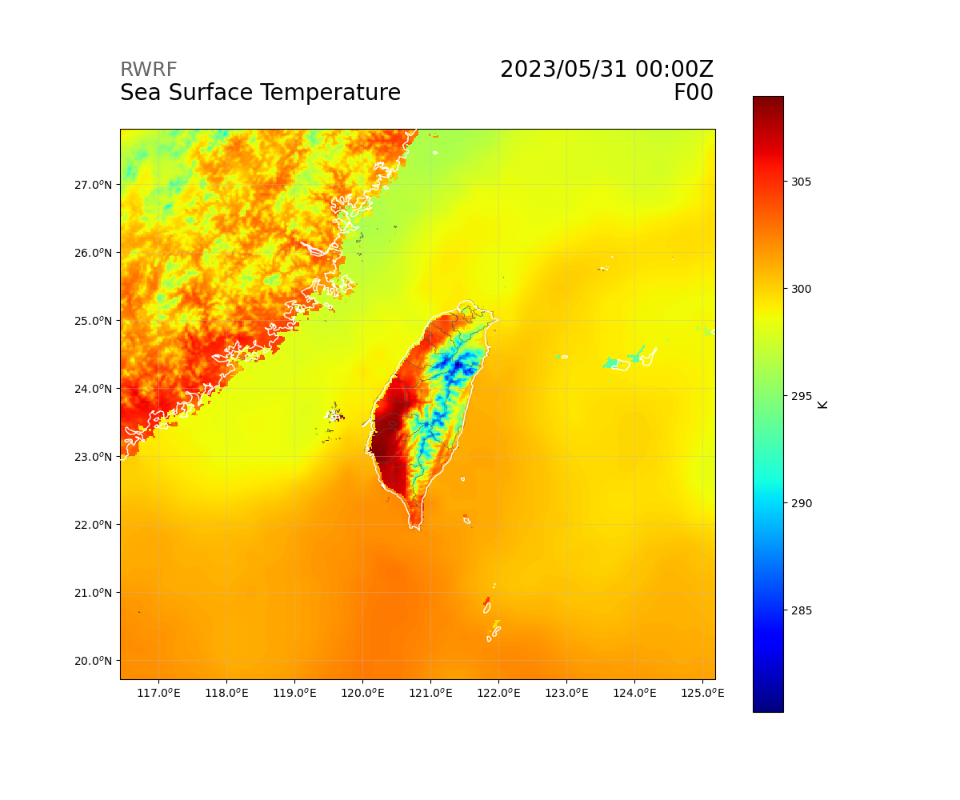
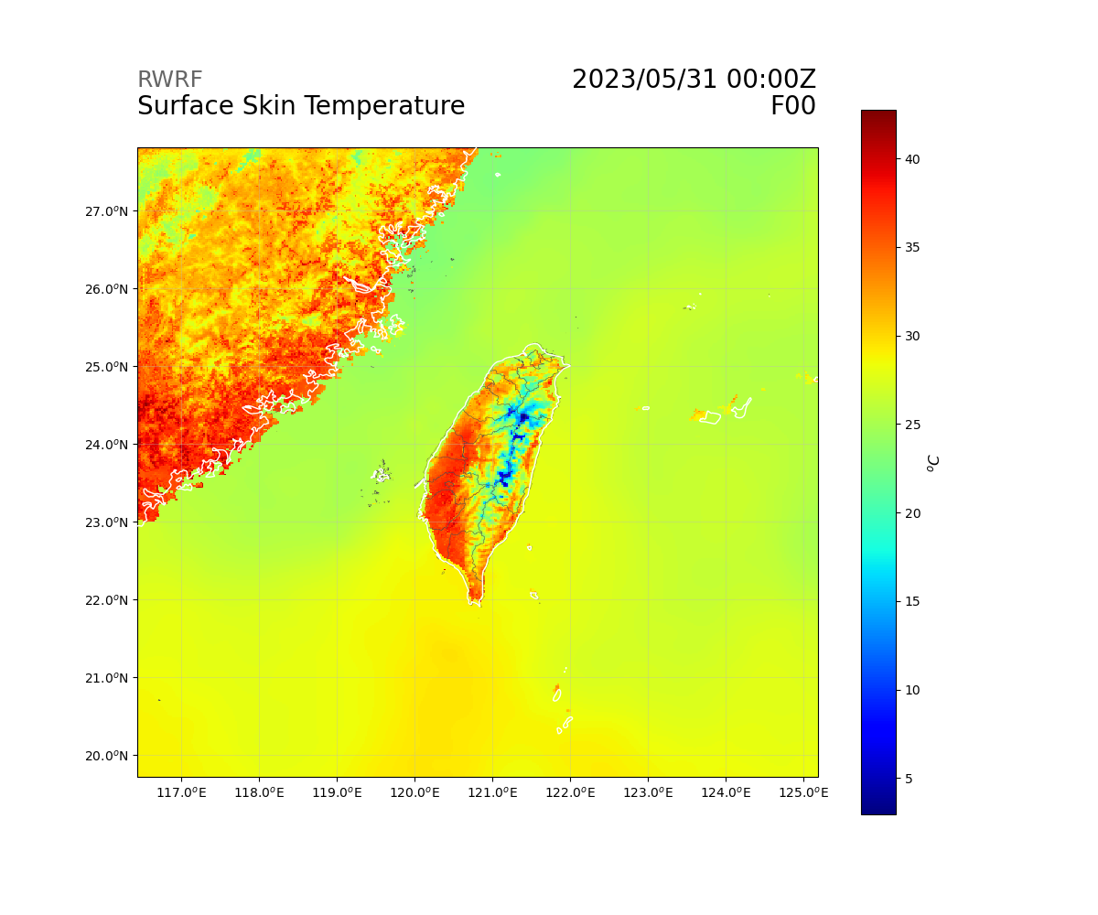
Variables (Ground)
float SST(Time, south_north, west_east) ;
SST:FieldType = 104 ;
SST:MemoryOrder = "XY " ;
SST:description = "SEA SURFACE TEMPERATURE" ;
SST:units = "K" ;
SST:stagger = "" ;
SST:coordinates = "XLONG XLAT XTIME" ;
float SSTSK(Time, south_north, west_east) ;
SSTSK:FieldType = 104 ;
SSTSK:MemoryOrder = "XY " ;
SSTSK:description = "SKIN SEA SURFACE TEMPERATURE" ;
SSTSK:units = "K" ;
SSTSK:stagger = "" ;
SSTSK:coordinates = "XLONG XLAT XTIME" ;
float TSK(Time, south_north, west_east) ;
TSK:FieldType = 104 ;
TSK:MemoryOrder = "XY " ;
TSK:description = "SURFACE SKIN TEMPERATURE" ;
TSK:units = "K" ;
TSK:stagger = "" ;
TSK:coordinates = "XLONG XLAT XTIME" ;

Slide 29
Variables (Column)
float UST(Time, south_north, west_east) ;
UST:FieldType = 104 ;
UST:MemoryOrder = "XY " ;
UST:description = "U* IN SIMILARITY THEORY" ;
UST:units = "m s-1" ;
UST:stagger = "" ;
UST:coordinates = "XLONG XLAT XTIME" ;
float PBLH(Time, south_north, west_east) ;
PBLH:FieldType = 104 ;
PBLH:MemoryOrder = "XY " ;
PBLH:description = "PBL HEIGHT" ;
PBLH:units = "m" ;
PBLH:stagger = "" ;
PBLH:coordinates = "XLONG XLAT XTIME" ;

Slide 30
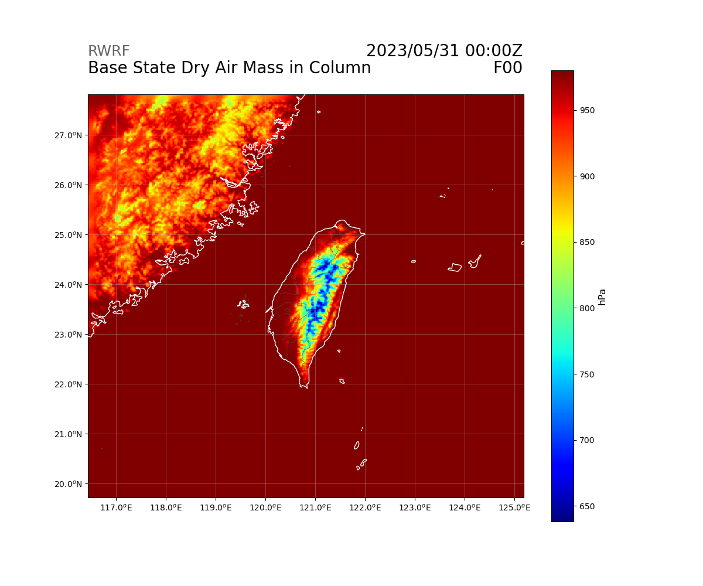
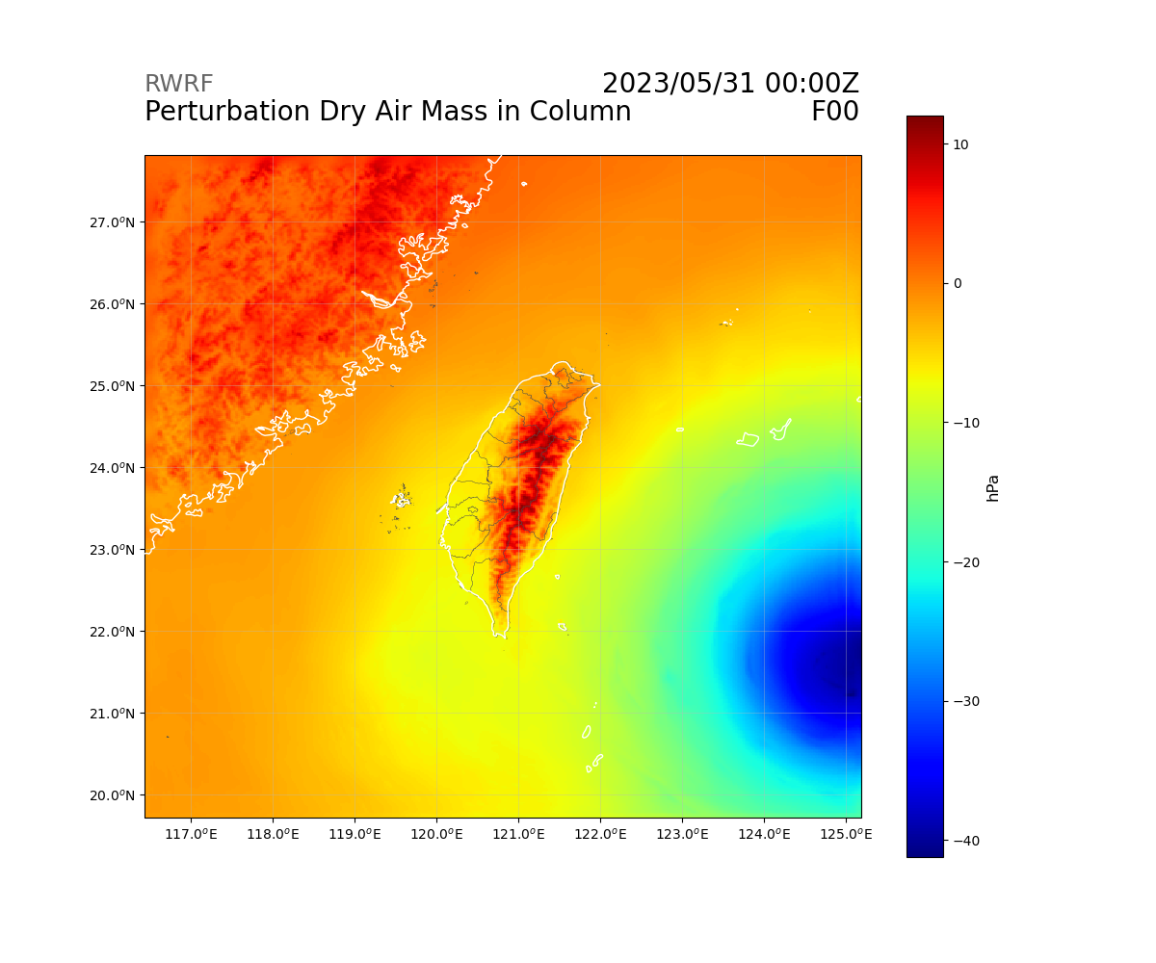
Variables (Column)
float MUB(Time, south_north, west_east) ;
MUB:FieldType = 104 ;
MUB:MemoryOrder = "XY " ;
MUB:description = "base state dry air mass in column" ;
MUB:units = "Pa" ;
MUB:stagger = "" ;
MUB:coordinates = "XLONG XLAT XTIME" ;
float MU(Time, south_north, west_east) ;
MU:FieldType = 104 ;
MU:MemoryOrder = "XY " ;
MU:description = "perturbation dry air mass in column" ;
MU:units = "Pa" ;
MU:stagger = "" ;
MU:coordinates = "XLONG XLAT XTIME" ;

Slide 31
Variables (Runoff)
float SFROFF(Time, south_north, west_east) ;
SFROFF:FieldType = 104 ;
SFROFF:MemoryOrder = "XY " ;
SFROFF:description = "SURFACE RUNOFF" ;
SFROFF:units = "mm" ;
SFROFF:stagger = "" ;
SFROFF:coordinates = "XLONG XLAT XTIME" ;
float UDROFF(Time, south_north, west_east) ;
UDROFF:FieldType = 104 ;
UDROFF:MemoryOrder = "XY " ;
UDROFF:description = "UNDERGROUND RUNOFF" ;
UDROFF:units = "mm" ;
UDROFF:stagger = "" ;
UDROFF:coordinates = "XLONG XLAT XTIME" ;

Slide 32
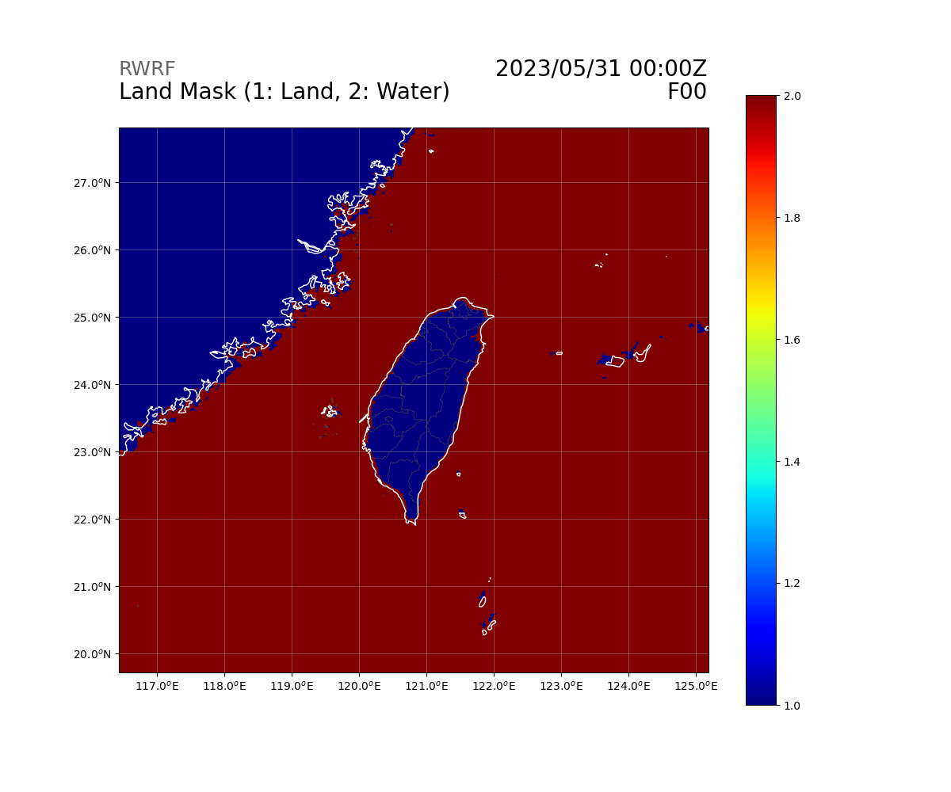
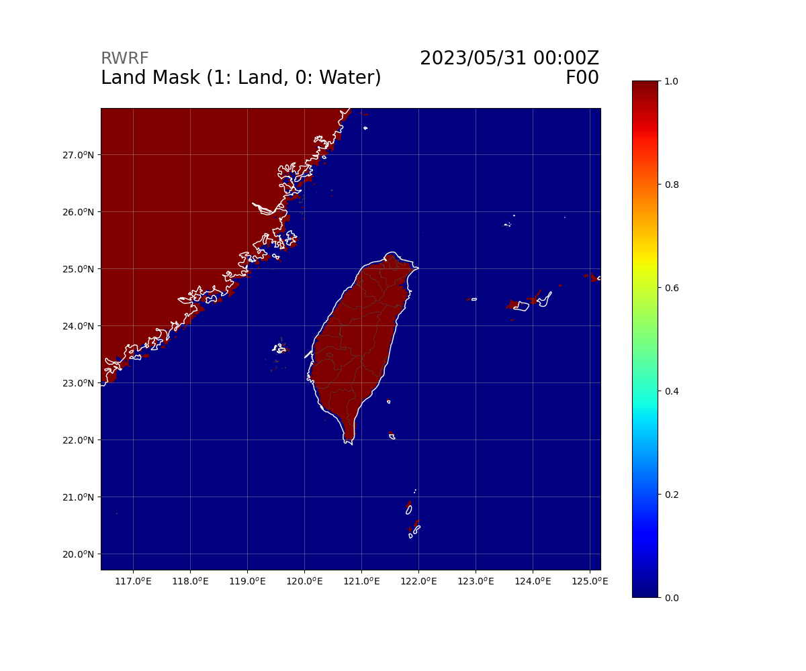
Variables (Mask)
float XLAND(Time, south_north, west_east) ;
XLAND:FieldType = 104 ;
XLAND:MemoryOrder = "XY " ;
XLAND:description = "LAND MASK (1 FOR LAND, 2 FOR WATER)" ;
XLAND:units = "" ;
XLAND:stagger = "" ;
XLAND:coordinates = "XLONG XLAT XTIME" ;
float LANDMASK(Time, south_north, west_east) ;
LANDMASK:FieldType = 104 ;
LANDMASK:MemoryOrder = "XY " ;
LANDMASK:description = "LAND MASK (1 FOR LAND, 0 FOR WATER)" ;
LANDMASK:units = "" ;
LANDMASK:stagger = "" ;
LANDMASK:coordinates = "XLONG XLAT XTIME" ;

Slide 33
Variables - Flux

Slide 34
Variables (Flux)
float GRDFLX(Time, south_north, west_east) ;
GRDFLX:FieldType = 104 ;
GRDFLX:MemoryOrder = "XY " ;
GRDFLX:description = "GROUND HEAT FLUX" ;
GRDFLX:units = "W m-2" ;
GRDFLX:stagger = "" ;
GRDFLX:coordinates = "XLONG XLAT XTIME" ;
float ACGRDFLX(Time, south_north, west_east) ;
ACGRDFLX:FieldType = 104 ;
ACGRDFLX:MemoryOrder = "XY " ;
ACGRDFLX:description = "ACCUMULATED GROUND HEAT FLUX" ;
ACGRDFLX:units = "J m-2" ;
ACGRDFLX:stagger = "" ;
ACGRDFLX:coordinates = "XLONG XLAT XTIME" ;

Slide 35
Variables (Flux)
float HFX(Time, south_north, west_east) ;
HFX:FieldType = 104 ;
HFX:MemoryOrder = "XY " ;
HFX:description = "UPWARD HEAT FLUX AT THE SURFACE" ;
HFX:units = "W m-2" ;
HFX:stagger = "" ;
HFX:coordinates = "XLONG XLAT XTIME" ;
float ACHFX(Time, south_north, west_east) ;
ACHFX:FieldType = 104 ;
ACHFX:MemoryOrder = "XY " ;
ACHFX:description = "ACCUMULATED UPWARD HEAT FLUX AT THE SURFACE" ;
ACHFX:units = "J m-2" ;
ACHFX:stagger = "" ;
ACHFX:coordinates = "XLONG XLAT XTIME" ;
float QFX(Time, south_north, west_east) ;
QFX:FieldType = 104 ;
QFX:MemoryOrder = "XY " ;
QFX:description = "UPWARD MOISTURE FLUX AT THE SURFACE" ;
QFX:units = "kg m-2 s-1" ;
QFX:stagger = "" ;
QFX:coordinates = "XLONG XLAT XTIME" ;

Slide 36
Variables (Flux)
float LH(Time, south_north, west_east) ;
LH:FieldType = 104 ;
LH:MemoryOrder = "XY " ;
LH:description = "LATENT HEAT FLUX AT THE SURFACE" ;
LH:units = "W m-2" ;
LH:stagger = "" ;
LH:coordinates = "XLONG XLAT XTIME" ;
float ACLHF(Time, south_north, west_east) ;
ACLHF:FieldType = 104 ;
ACLHF:MemoryOrder = "XY " ;
ACLHF:description = "ACCUMULATED UPWARD LATENT HEAT FLUX AT THE SURFACE" ;
ACLHF:units = "J m-2" ;
ACLHF:stagger = "" ;
ACLHF:coordinates = "XLONG XLAT XTIME" ;

Slide 37
Variables (Ground)
float SWDOWN(Time, south_north, west_east) ;
SWDOWN:FieldType = 104 ;
SWDOWN:MemoryOrder = "XY " ;
SWDOWN:description = "DOWNWARD SHORT WAVE FLUX AT GROUND SURFACE" ;
SWDOWN:units = "W m-2" ;
SWDOWN:stagger = "" ;
SWDOWN:coordinates = "XLONG XLAT XTIME" ;
float SWNORM(Time, south_north, west_east) ;
SWNORM:FieldType = 104 ;
SWNORM:MemoryOrder = "XY " ;
SWNORM:description = "NORMAL SHORT WAVE FLUX AT GROUND SURFACE (SLOPE-DEPENDENT)" ;
SWNORM:units = "W m-2" ;
SWNORM:stagger = "" ;
SWNORM:coordinates = "XLONG XLAT XTIME" ;

Slide 38
Variables (Ground)
float GSW(Time, south_north, west_east) ;
GSW:FieldType = 104 ;
GSW:MemoryOrder = "XY " ;
GSW:description = "NET SHORT WAVE FLUX AT GROUND SURFACE" ;
GSW:units = "W m-2" ;
GSW:stagger = "" ;
GSW:coordinates = "XLONG XLAT XTIME" ;
float GLW(Time, south_north, west_east) ;
GLW:FieldType = 104 ;
GLW:MemoryOrder = "XY " ;
GLW:description = "DOWNWARD LONG WAVE FLUX AT GROUND SURFACE" ;
GLW:units = "W m-2" ;
GLW:stagger = "" ;
GLW:coordinates = "XLONG XLAT XTIME" ;
float OLR(Time, south_north, west_east) ;
OLR:FieldType = 104 ;
OLR:MemoryOrder = "XY " ;
OLR:description = "TOA OUTGOING LONG WAVE" ;
OLR:units = "W m-2" ;
OLR:stagger = "" ;
OLR:coordinates = "XLONG XLAT XTIME" ;

Slide 39
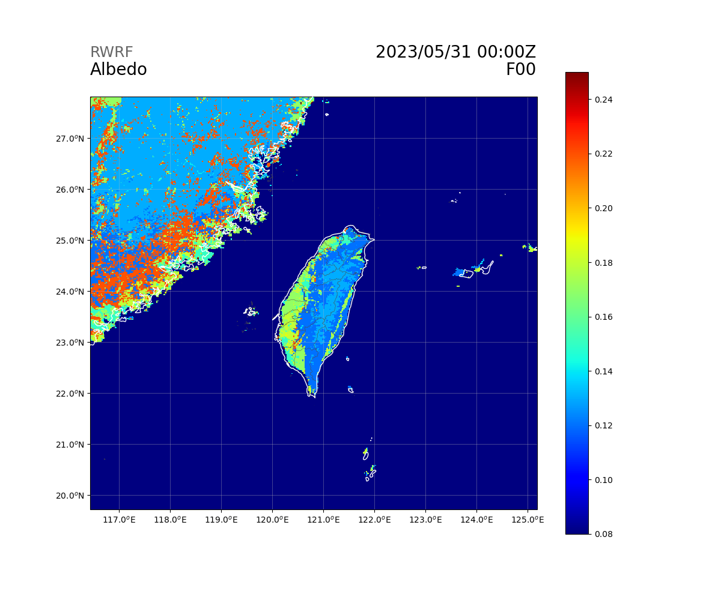

Variables (Flux)
float ALBEDO(Time, south_north, west_east) ;
ALBEDO:FieldType = 104 ;
ALBEDO:MemoryOrder = "XY " ;
ALBEDO:description = "ALBEDO" ;
ALBEDO:units = "-" ;
ALBEDO:stagger = "" ;
ALBEDO:coordinates = "XLONG XLAT XTIME" ;
float ALBBCK(Time, south_north, west_east) ;
ALBBCK:FieldType = 104 ;
ALBBCK:MemoryOrder = "XY " ;
ALBBCK:description = "BACKGROUND ALBEDO" ;
ALBBCK:units = "" ;
ALBBCK:stagger = "" ;
ALBBCK:coordinates = "XLONG XLAT XTIME" ;

Slide 40
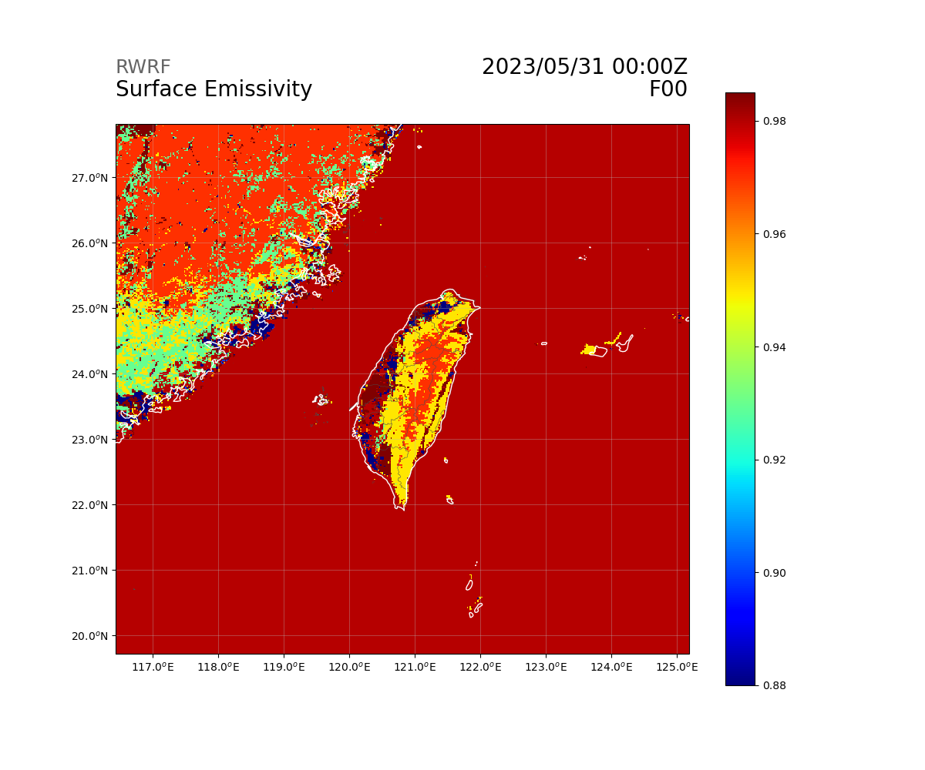
Variables (Flux)
float EMISS(Time, south_north, west_east) ;
EMISS:FieldType = 104 ;
EMISS:MemoryOrder = "XY " ;
EMISS:description = "SURFACE EMISSIVITY" ;
EMISS:units = "" ;
EMISS:stagger = "" ;
EMISS:coordinates = "XLONG XLAT XTIME" ;
float NOAHRES(Time, south_north, west_east) ;
NOAHRES:FieldType = 104 ;
NOAHRES:MemoryOrder = "XY " ;
NOAHRES:description = "RESIDUAL OF THE NOAH SURFACE ENERGY BUDGET" ;
NOAHRES:units = "W m{-2}" ;
NOAHRES:stagger = "" ;
NOAHRES:coordinates = "XLONG XLAT XTIME" ;

Slide 41
Variables - Upper Air

Slide 42
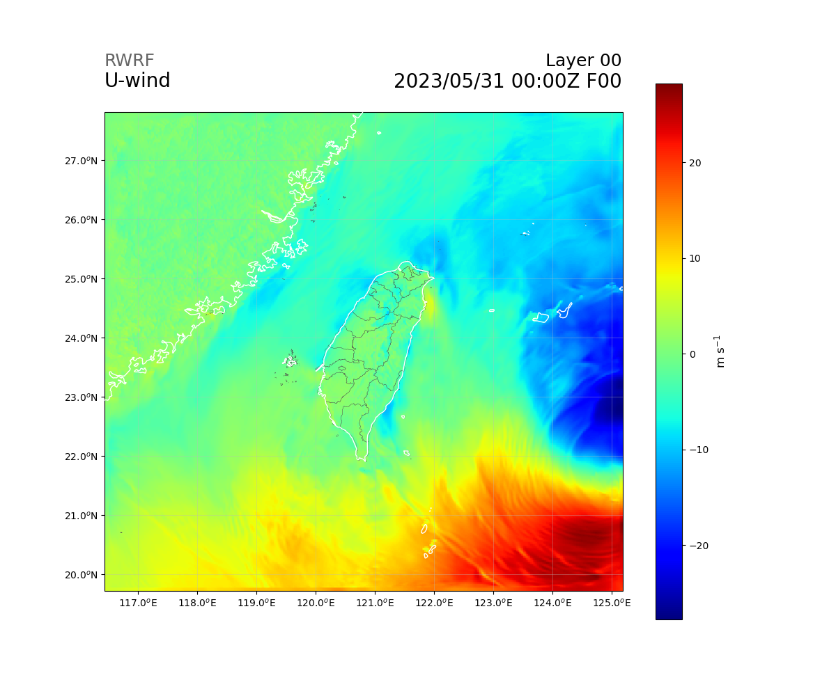

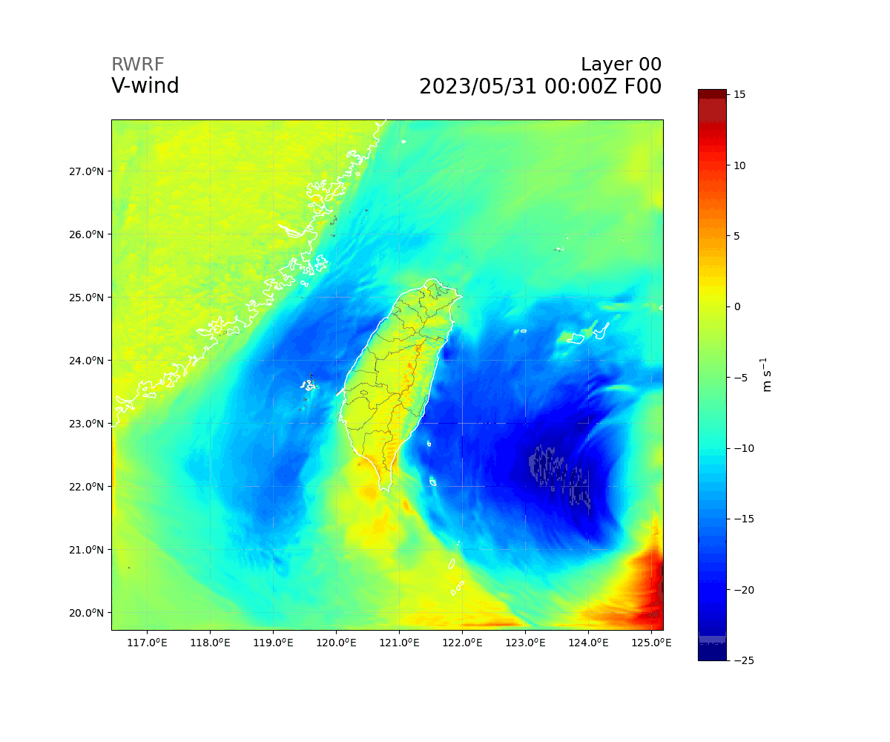

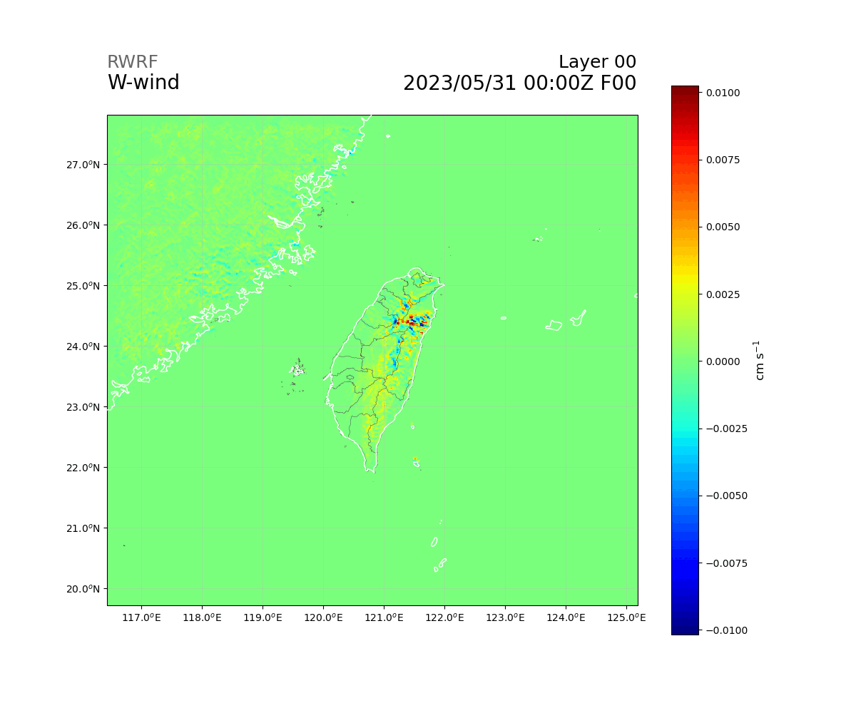

Variables (Upper Air - Wind)
float U(Time, bottom_top, south_north, west_east_stag) ;
U:FieldType = 104 ;
U:MemoryOrder = "XYZ" ;
U:description = "x-wind component" ;
U:units = "m s-1" ;
U:stagger = "X" ;
U:coordinates = "XLONG_U XLAT_U XTIME" ;
float V(Time, bottom_top, south_north_stag, west_east) ;
V:FieldType = 104 ;
V:MemoryOrder = "XYZ" ;
V:description = "y-wind component" ;
V:units = "m s-1" ;
V:stagger = "Y" ;
V:coordinates = "XLONG_V XLAT_V XTIME" ;
float W(Time, bottom_top_stag, south_north, west_east) ;
W:FieldType = 104 ;
W:MemoryOrder = "XYZ" ;
W:description = "z-wind component" ;
W:units = "m s-1" ;
W:stagger = "Z" ;
W:coordinates = "XLONG XLAT XTIME" ;

Slide 43
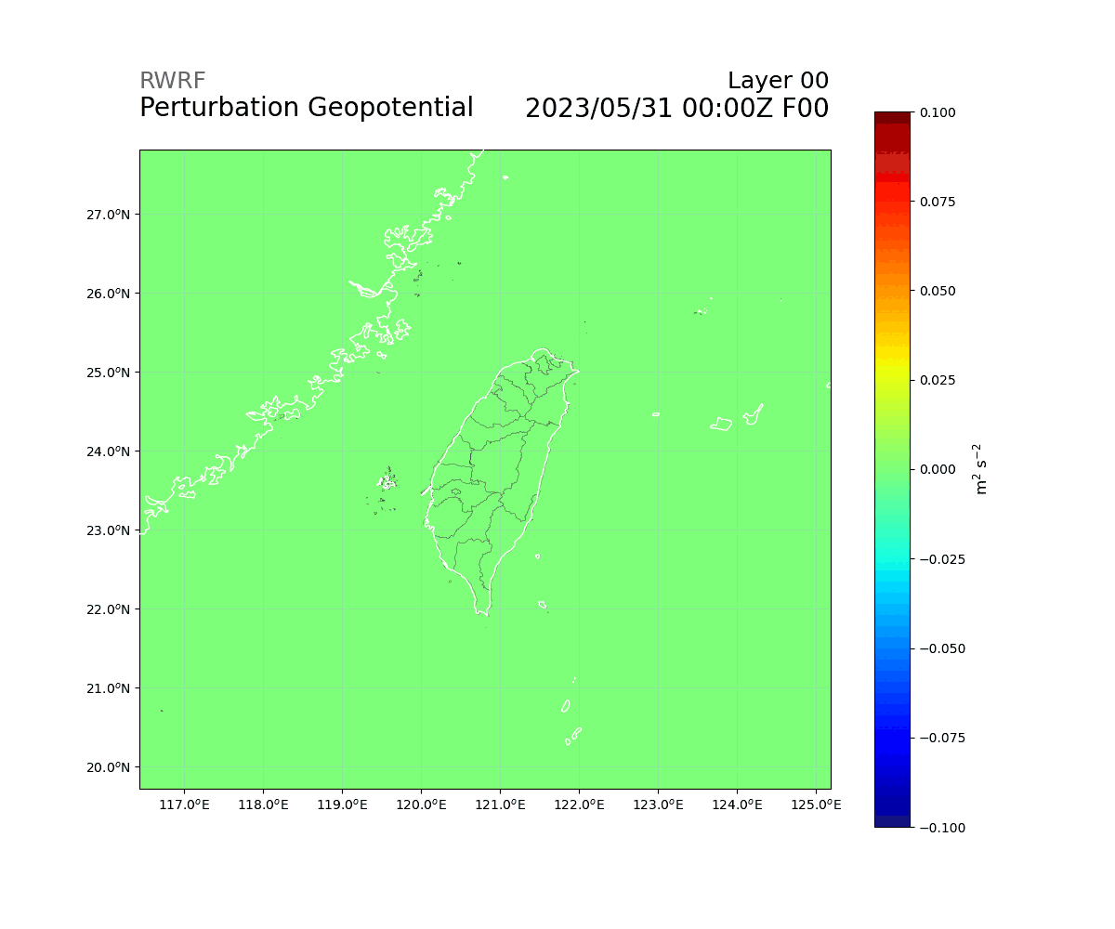
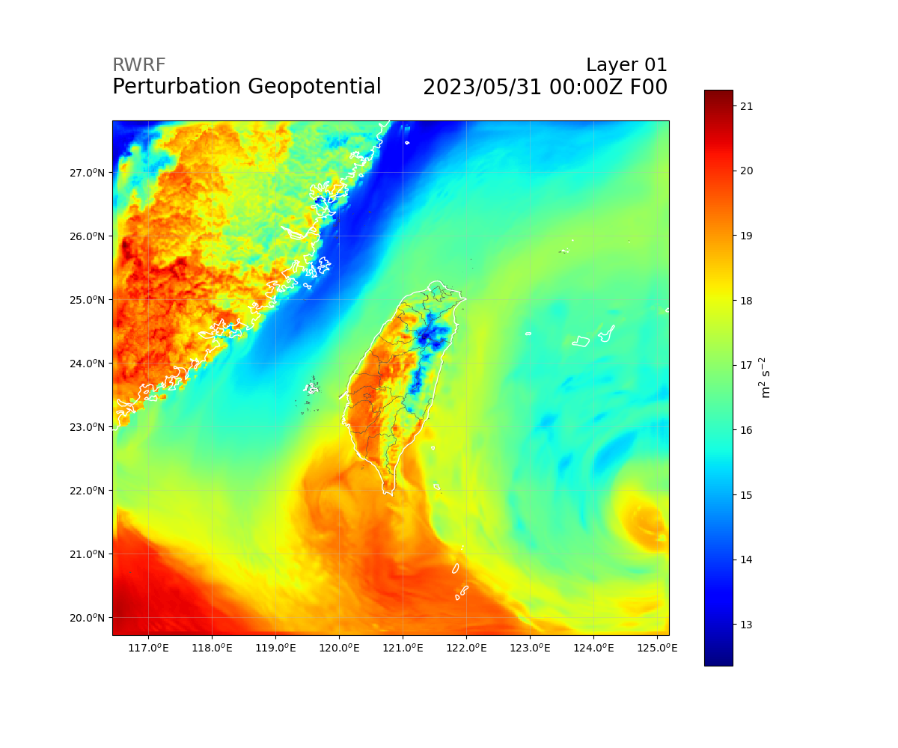
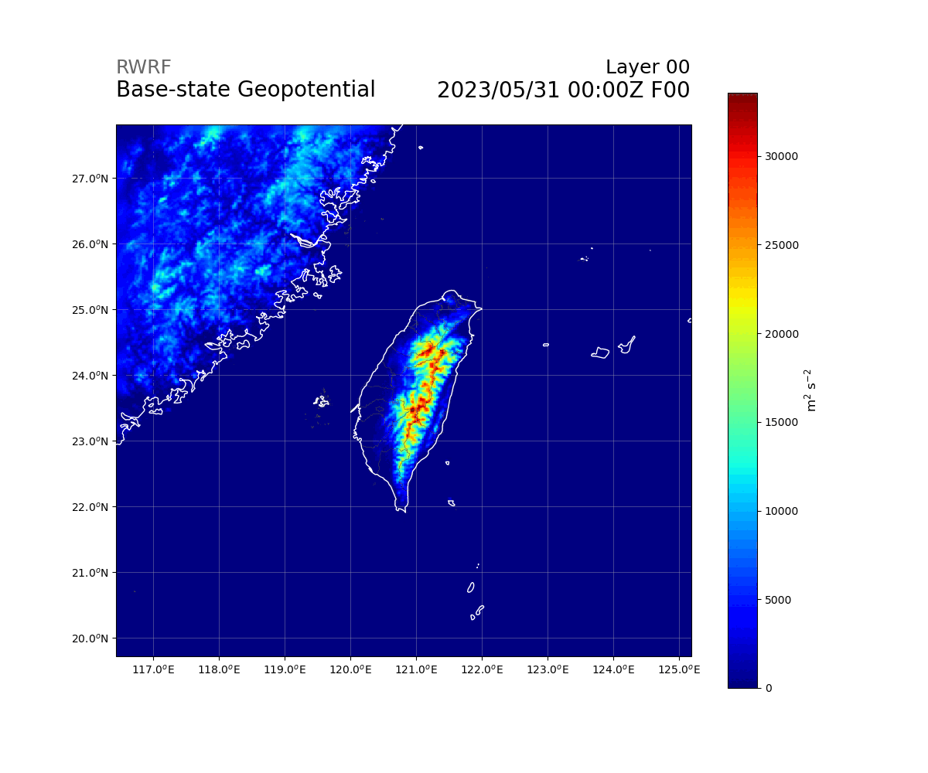
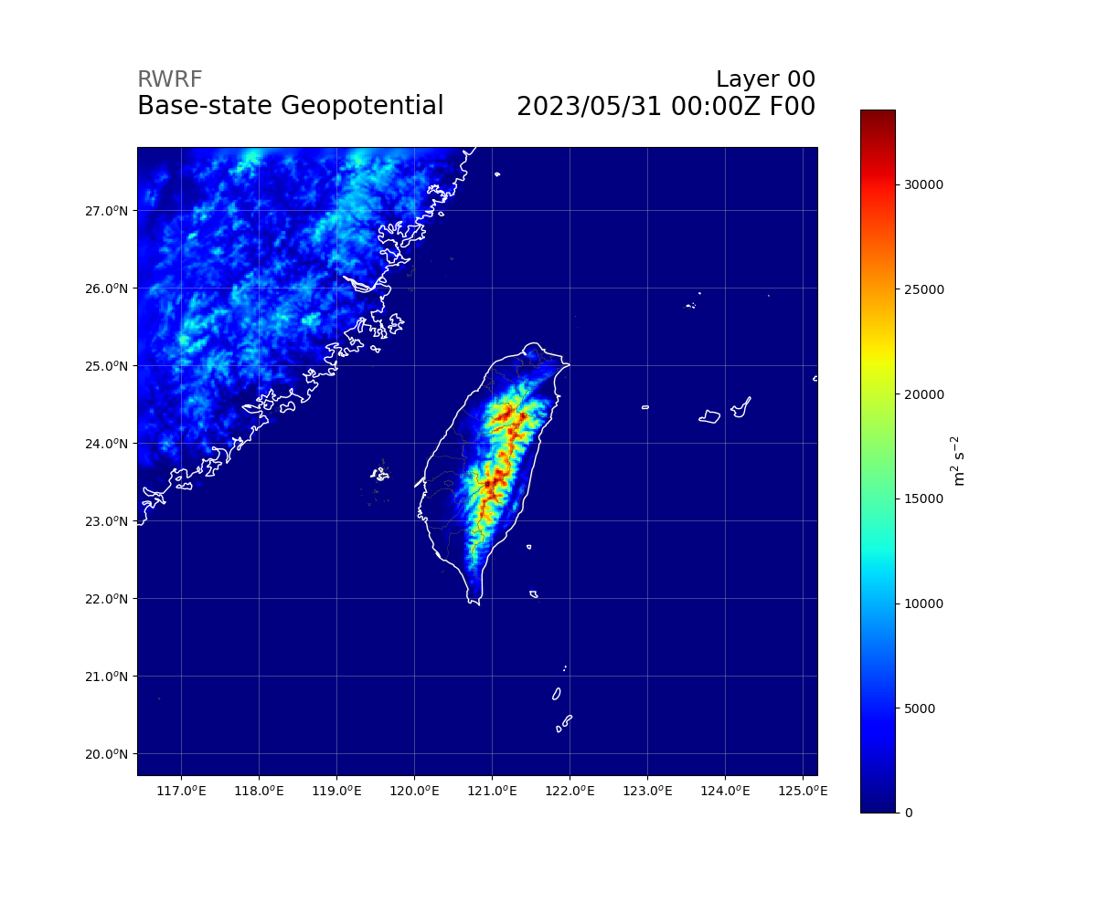


Variables (Upper Air)
float PH(Time, bottom_top_stag, south_north, west_east) ;
PH:FieldType = 104 ;
PH:MemoryOrder = "XYZ" ;
PH:description = "perturbation geopotential" ;
PH:units = "m2 s-2" ;
PH:stagger = "Z" ;
PH:coordinates = "XLONG XLAT XTIME" ;
float PHB(Time, bottom_top_stag, south_north, west_east) ;
PHB:FieldType = 104 ;
PHB:MemoryOrder = "XYZ" ;
PHB:description = "base-state geopotential" ;
PHB:units = "m2 s-2" ;
PHB:stagger = "Z" ;
PHB:coordinates = "XLONG XLAT XTIME" ;
float T(Time, bottom_top, south_north, west_east) ;
T:FieldType = 104 ;
T:MemoryOrder = "XYZ" ;
T:description = "perturbation potential temperature (theta-t0)" ;
T:units = "K" ;
T:stagger = "" ;
T:coordinates = "XLONG XLAT XTIME" ;

Slide 44
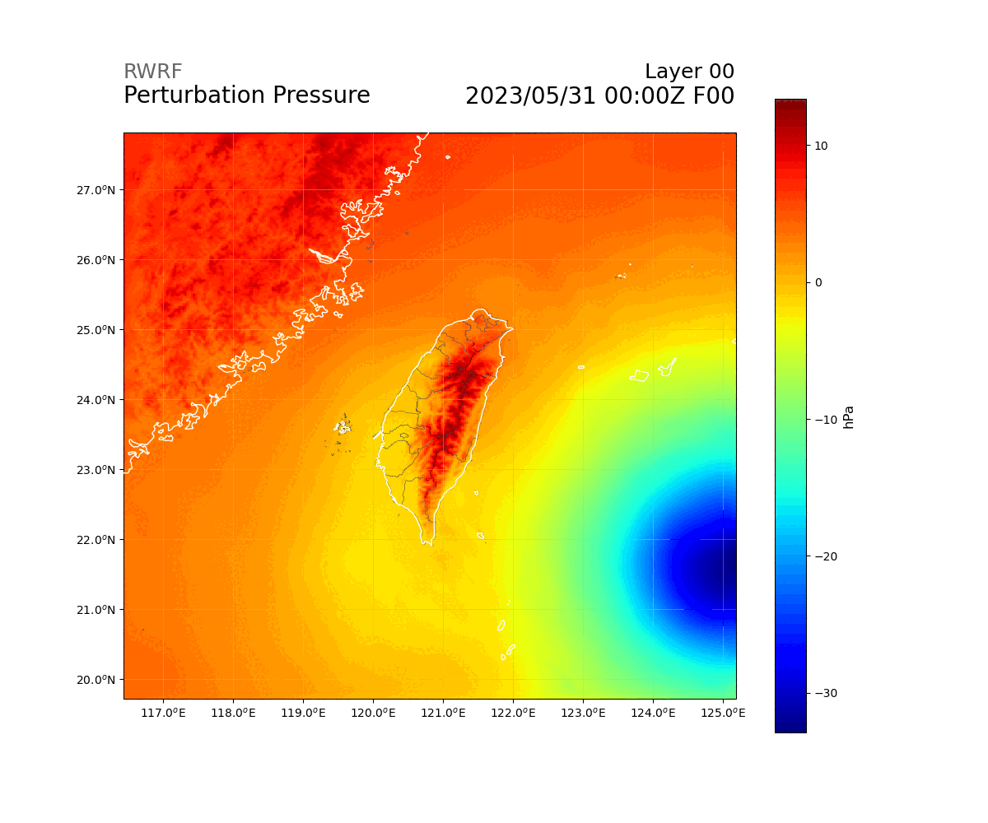



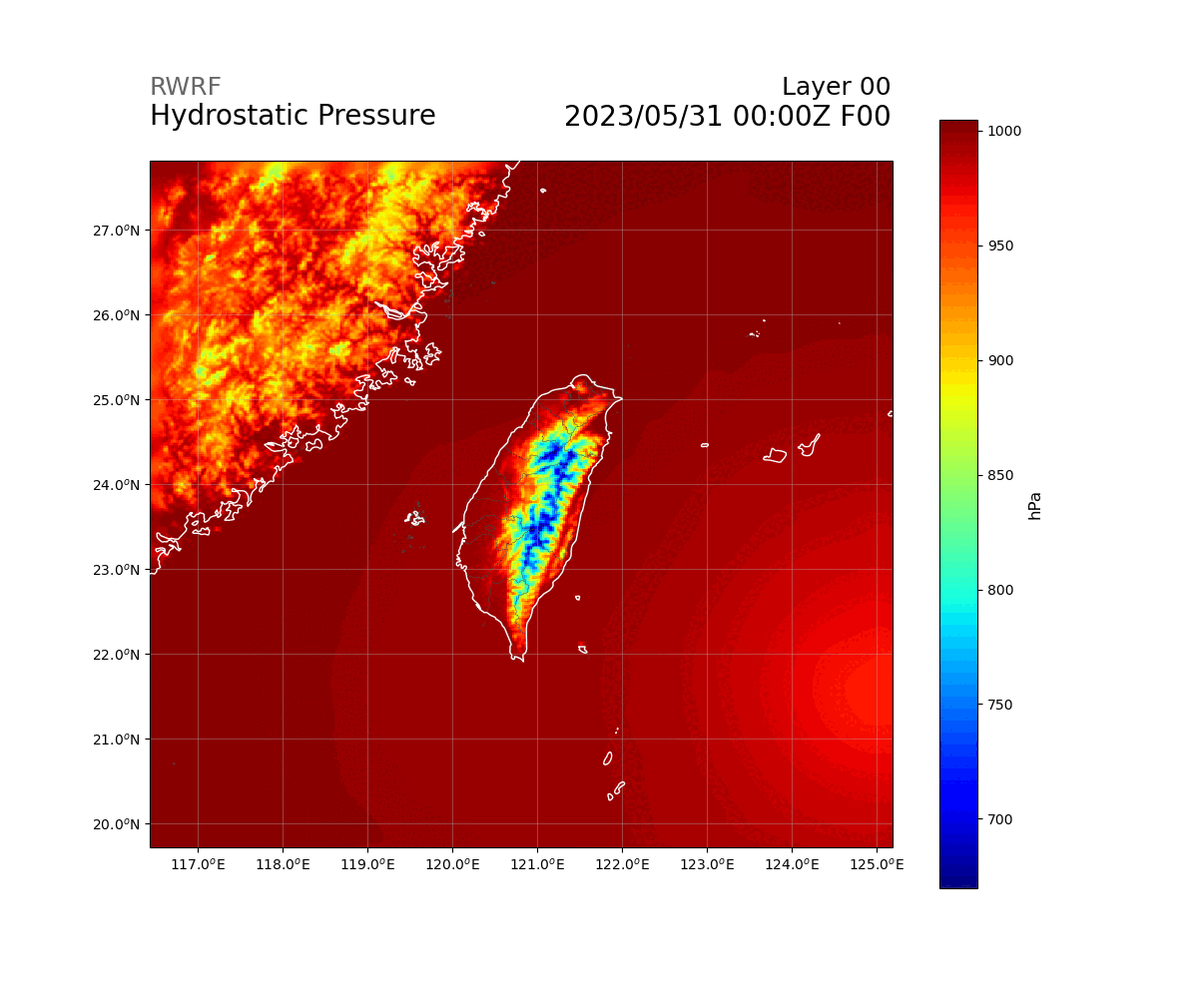

Variables (Upper Air - P)
float P(Time, bottom_top, south_north, west_east) ;
P:FieldType = 104 ;
P:MemoryOrder = "XYZ" ;
P:description = "perturbation pressure" ;
P:units = "Pa" ;
P:stagger = "" ;
P:coordinates = "XLONG XLAT XTIME" ;
float PB(Time, bottom_top, south_north, west_east) ;
PB:FieldType = 104 ;
PB:MemoryOrder = "XYZ" ;
PB:description = "BASE STATE PRESSURE" ;
PB:units = "Pa" ;
PB:stagger = "" ;
PB:coordinates = "XLONG XLAT XTIME" ;
float P_HYD(Time, bottom_top, south_north, west_east) ;
P_HYD:FieldType = 104 ;
P_HYD:MemoryOrder = "XYZ" ;
P_HYD:description = "hydrostatic pressure" ;
P_HYD:units = "Pa" ;
P_HYD:stagger = "" ;
P_HYD:coordinates = "XLONG XLAT XTIME" ;

Slide 45
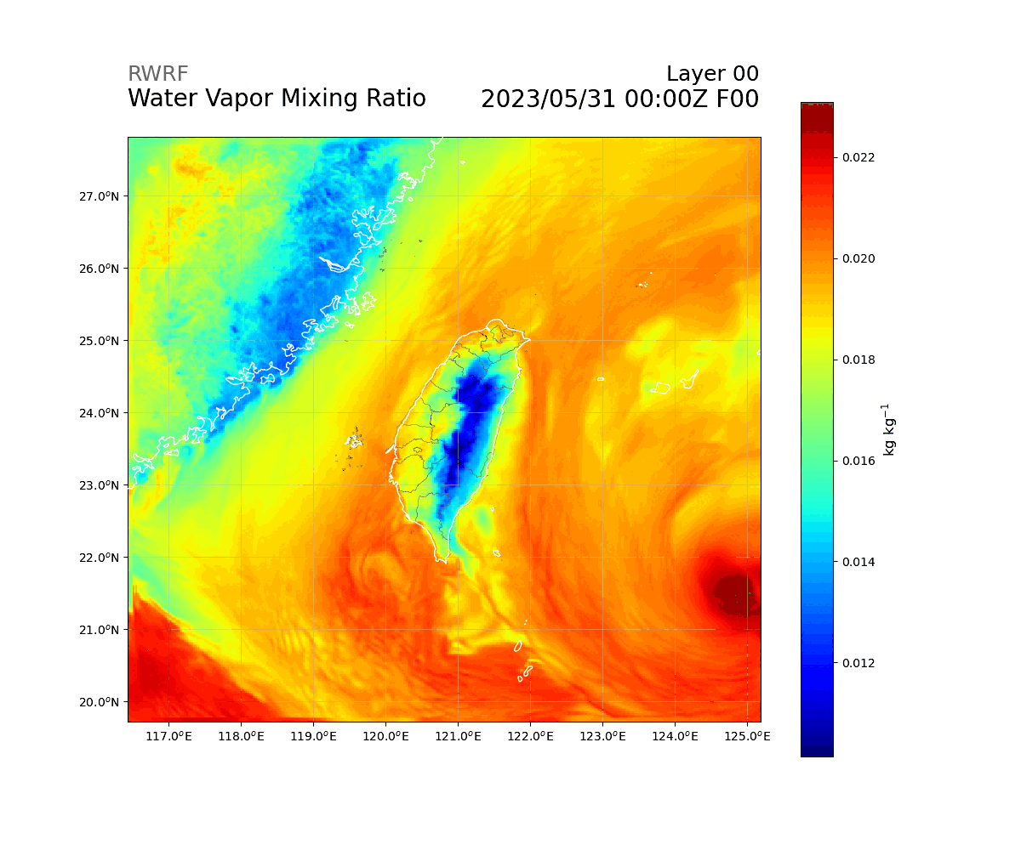

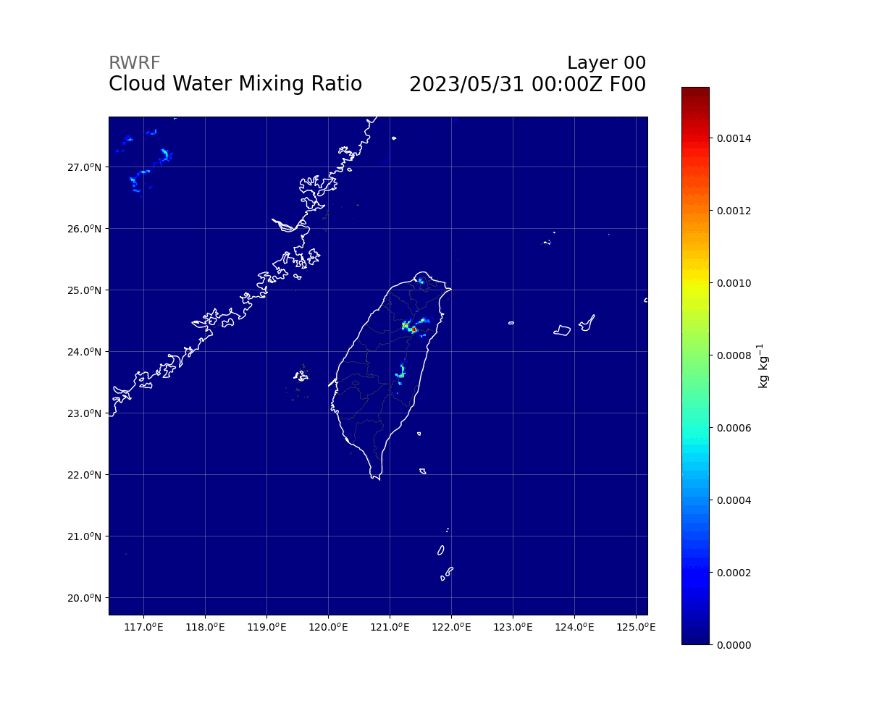

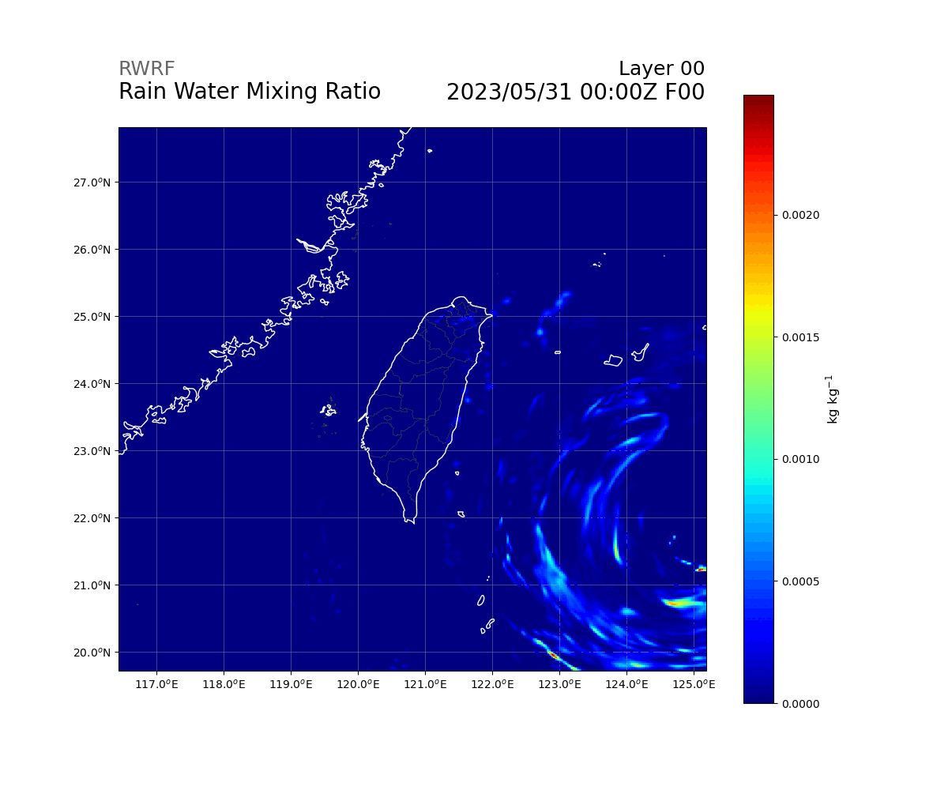

Variables (Upper Air - Q)
float QVAPOR(Time, bottom_top, south_north, west_east) ;
QVAPOR:FieldType = 104 ;
QVAPOR:MemoryOrder = "XYZ" ;
QVAPOR:description = "Water vapor mixing ratio" ;
QVAPOR:units = "kg kg-1" ;
QVAPOR:stagger = "" ;
QVAPOR:coordinates = "XLONG XLAT XTIME" ;
float QCLOUD(Time, bottom_top, south_north, west_east) ;
QCLOUD:FieldType = 104 ;
QCLOUD:MemoryOrder = "XYZ" ;
QCLOUD:description = "Cloud water mixing ratio" ;
QCLOUD:units = "kg kg-1" ;
QCLOUD:stagger = "" ;
QCLOUD:coordinates = "XLONG XLAT XTIME" ;
float QRAIN(Time, bottom_top, south_north, west_east) ;
QRAIN:FieldType = 104 ;
QRAIN:MemoryOrder = "XYZ" ;
QRAIN:description = "Rain water mixing ratio" ;
QRAIN:units = "kg kg-1" ;
QRAIN:stagger = "" ;
QRAIN:coordinates = "XLONG XLAT XTIME" ;

Slide 46
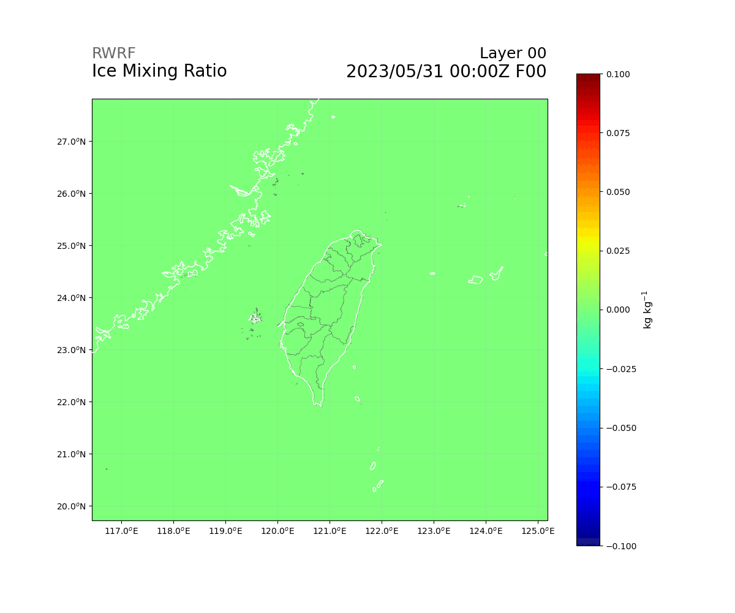
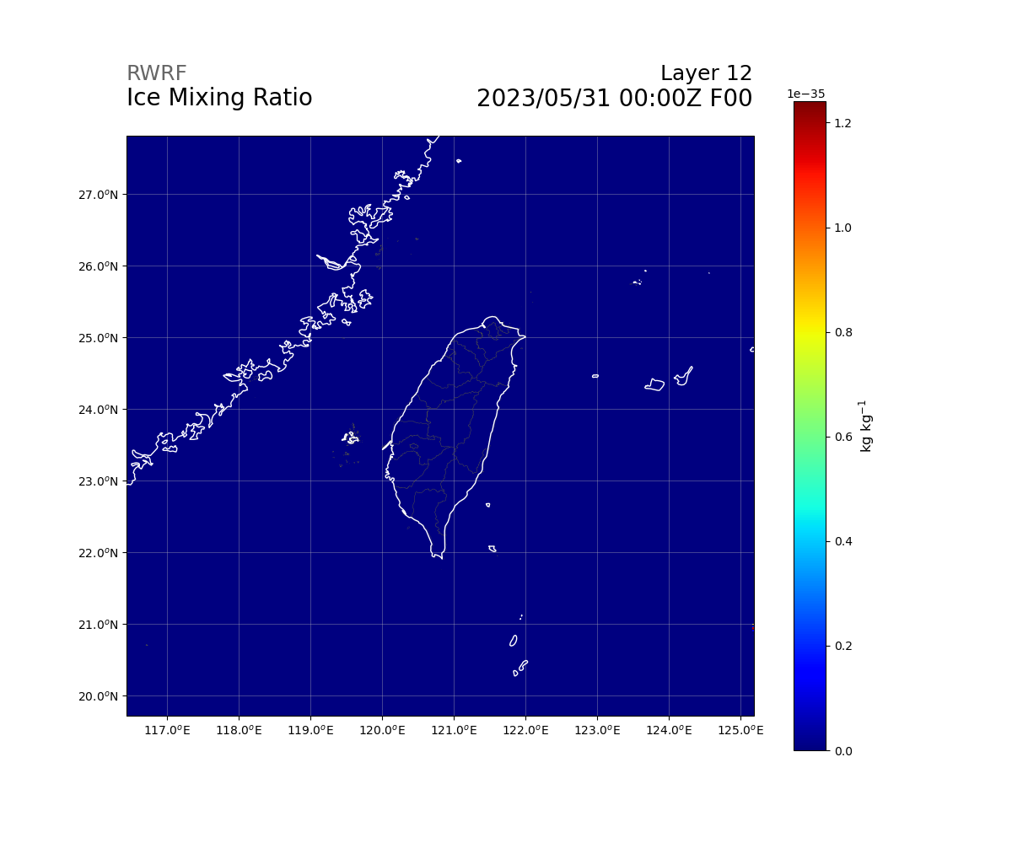
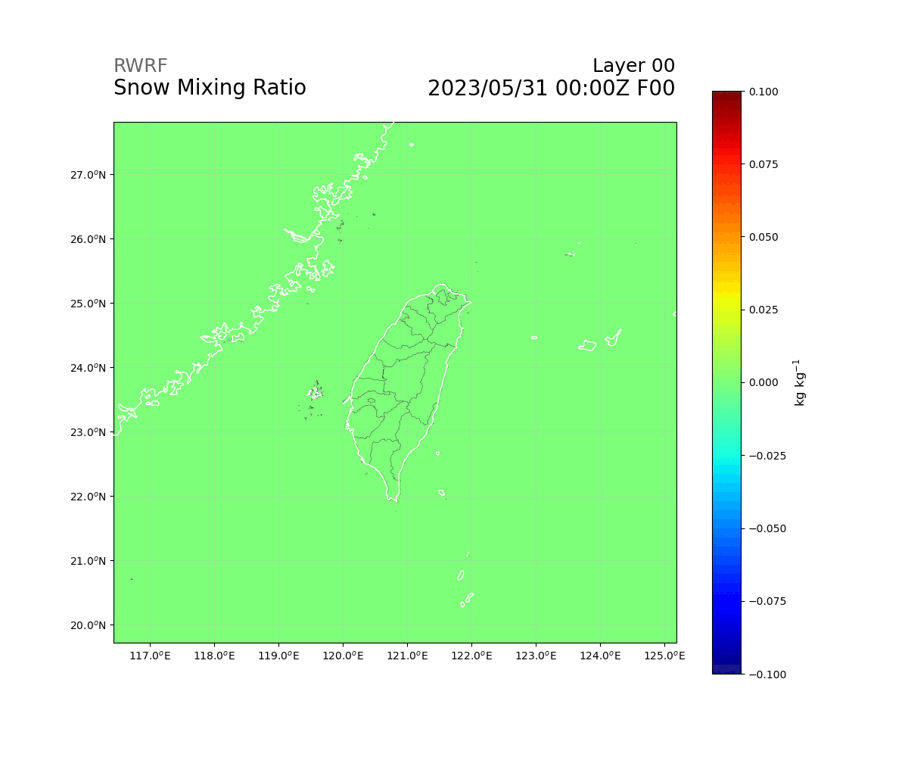
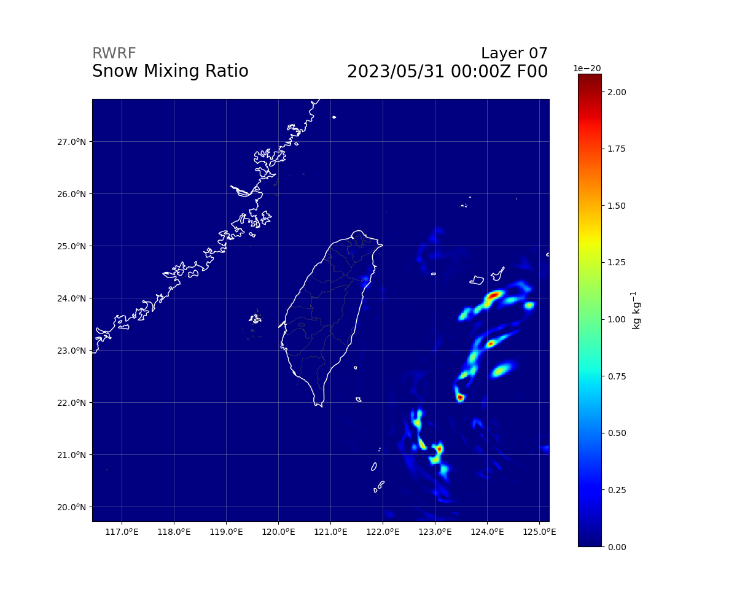
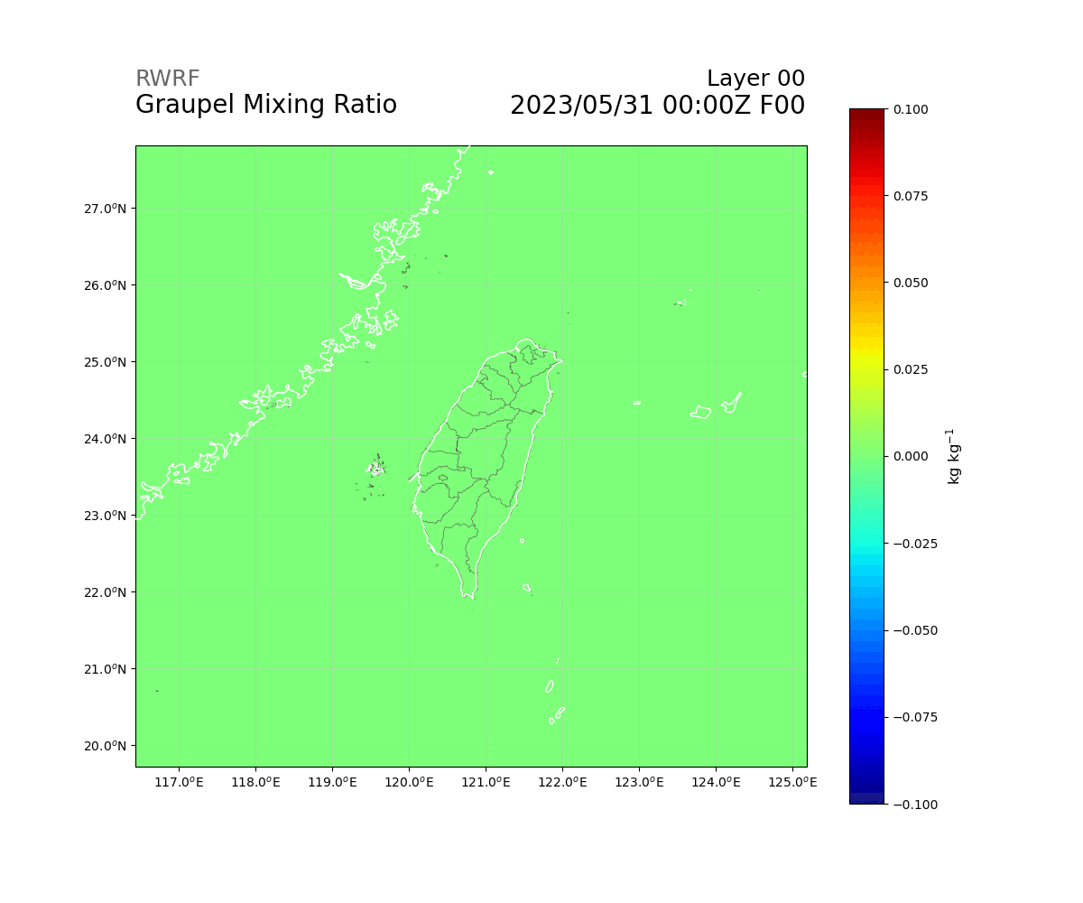
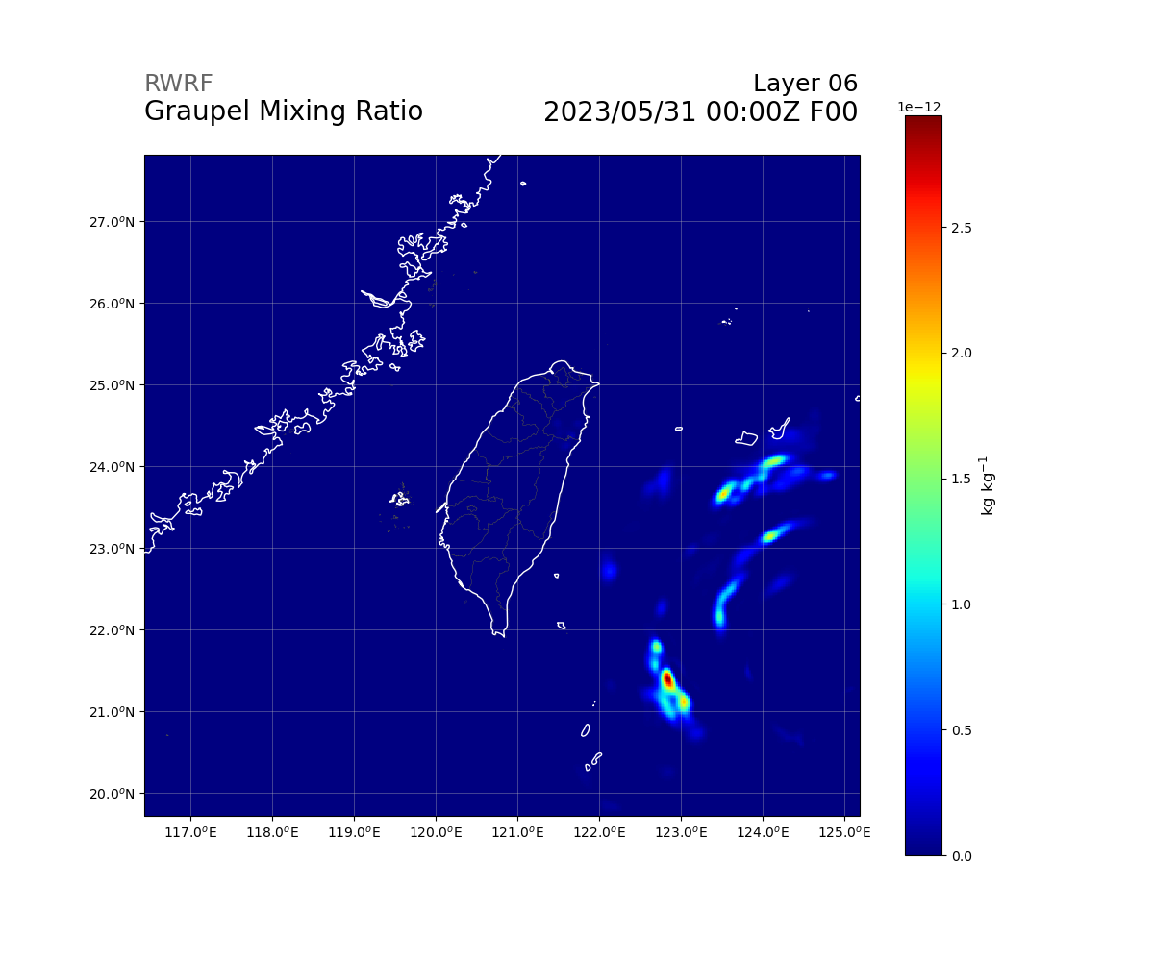
Variables (Upper Air - Q)
float QICE(Time, bottom_top, south_north, west_east) ;
QICE:FieldType = 104 ;
QICE:MemoryOrder = "XYZ" ;
QICE:description = "Ice mixing ratio" ;
QICE:units = "kg kg-1" ;
QICE:stagger = "" ;
QICE:coordinates = "XLONG XLAT XTIME" ;
float QSNOW(Time, bottom_top, south_north, west_east) ;
QSNOW:FieldType = 104 ;
QSNOW:MemoryOrder = "XYZ" ;
QSNOW:description = "Snow mixing ratio" ;
QSNOW:units = "kg kg-1" ;
QSNOW:stagger = "" ;
QSNOW:coordinates = "XLONG XLAT XTIME" ;
float QGRAUP(Time, bottom_top, south_north, west_east) ;
QGRAUP:FieldType = 104 ;
QGRAUP:MemoryOrder = "XYZ" ;
QGRAUP:description = "Graupel mixing ratio" ;
QGRAUP:units = "kg kg-1" ;
QGRAUP:stagger = "" ;
QGRAUP:coordinates = "XLONG XLAT XTIME" ;

Slide 47
After calculation (Upper Air - From Q)
def reflectivity_rams(QRAIN , QSNOW , QGRAUP):
refl = 264083.11 * (QRAIN + 0.2 * QSNOW + 2 * QGRAUP)
refl[refl < 1] = 1
refl = 17.8 * np.log10(refl)
refl[refl == 0] = -10
return refl

Slide 48
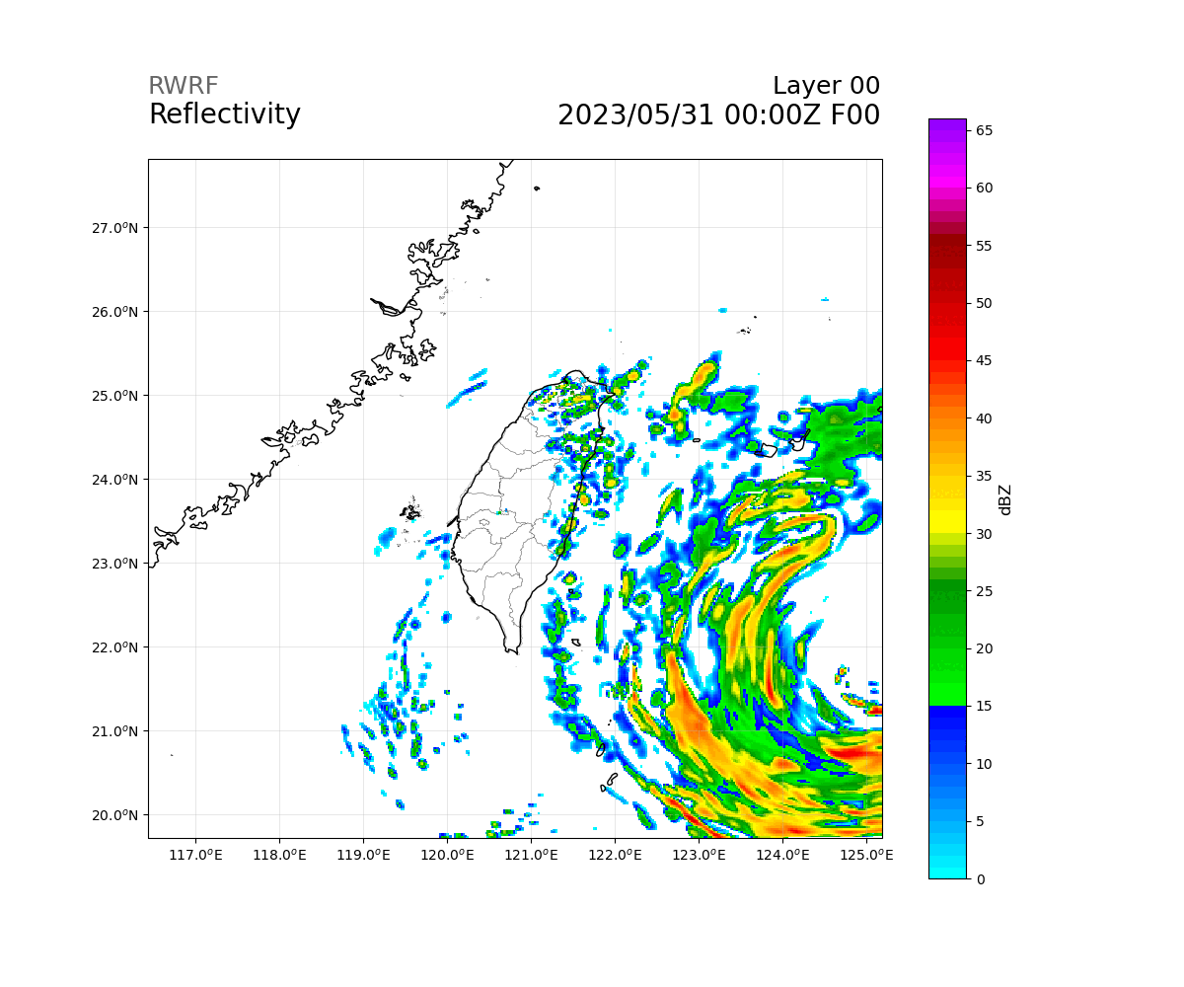
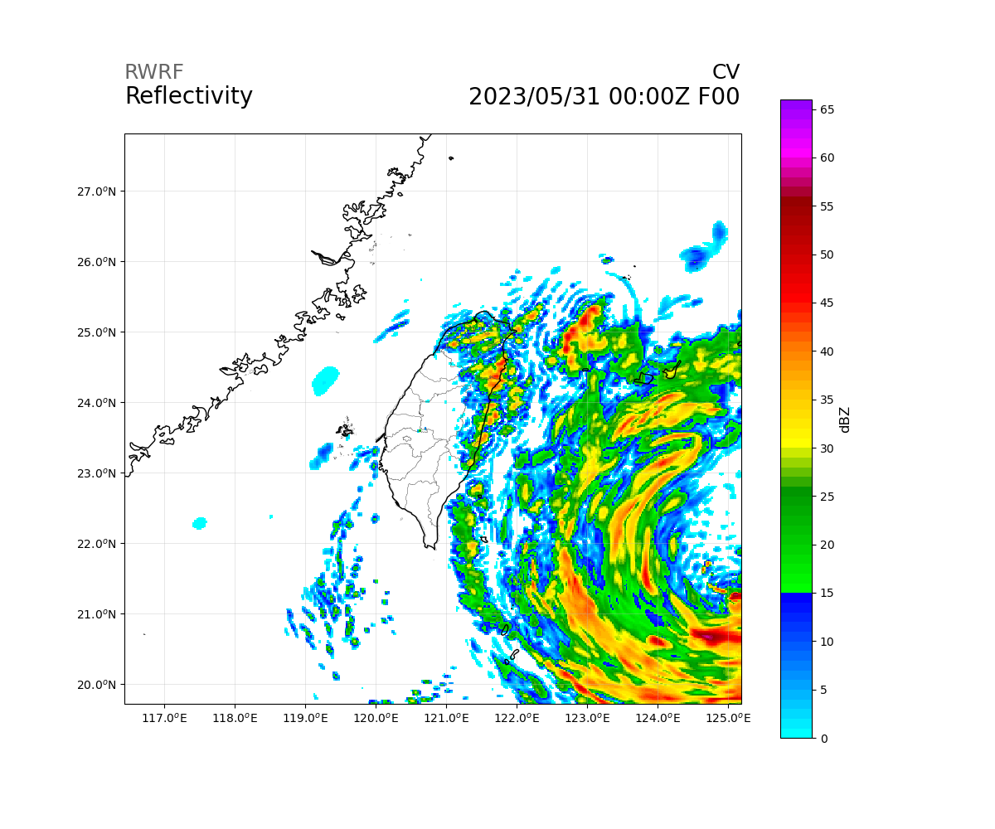
Output (Upper Air - From Q)
float Reflectivity(Time, bottom_top, south_north, west_east) ;
REFL:FieldType = 104 ;
REFL:MemoryOrder = "XYZ" ;
REFL:description = "Radar reflectivity" ;
REFL:units = "dBZ" ;
REFL:stagger = "" ;
REFL:coordinates = "XLONG XLAT XTIME" ;
float CV(Time, south_north, west_east) ;
CV:FieldType = 104 ;
CV:MemoryOrder = "XY" ;
CV:description = "Max reflectivity of columns" ;
CV:units = "dBZ" ;
CV:stagger = "" ;
CV:coordinates = "XLONG XLAT XTIME" ;

Slide 49
Variables (Upper Air)
float CLDFRA(Time, bottom_top, south_north, west_east) ;
CLDFRA:FieldType = 104 ;
CLDFRA:MemoryOrder = "XYZ" ;
CLDFRA:description = "CLOUD FRACTION" ;
CLDFRA:units = "" ;
CLDFRA:stagger = "" ;
CLDFRA:coordinates = "XLONG XLAT XTIME" ;

Slide 50
Variables - Soil

Slide 51
Variables (Soil)
float ZS(Time, soil_layers_stag) ;
ZS:FieldType = 104 ;
ZS:MemoryOrder = "Z " ;
ZS:description = "DEPTHS OF CENTERS OF SOIL LAYERS" ;
ZS:units = "m" ;
ZS:stagger = "Z" ;
float DZS(Time, soil_layers_stag) ;
DZS:FieldType = 104 ;
DZS:MemoryOrder = "Z " ;
DZS:description = "THICKNESSES OF SOIL LAYERS" ;
DZS:units = "m" ;
DZS:stagger = "Z" ;

Slide 52
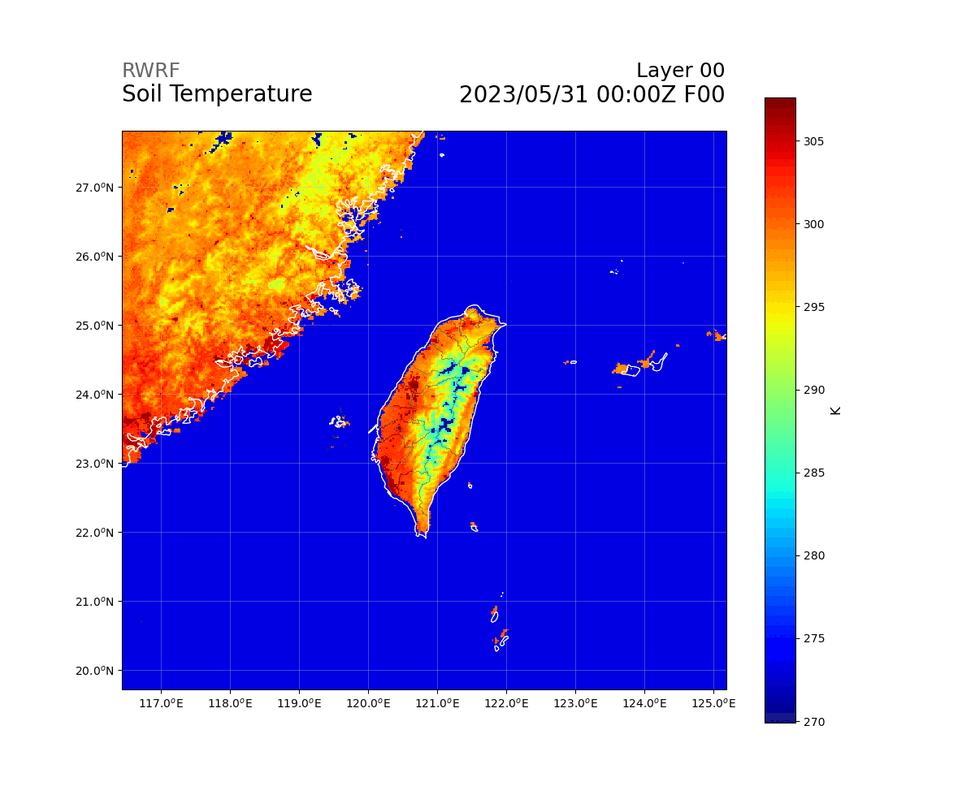

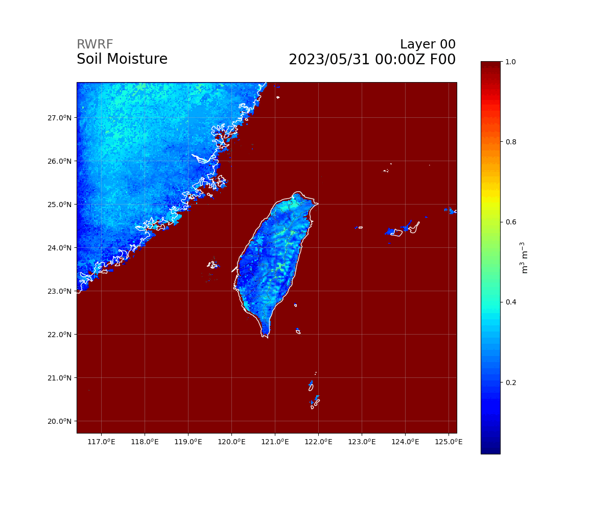

Variables (Soil)
float TSLB(Time, soil_layers_stag, south_north, west_east) ;
TSLB:FieldType = 104 ;
TSLB:MemoryOrder = "XYZ" ;
TSLB:description = "SOIL TEMPERATURE" ;
TSLB:units = "K" ;
TSLB:stagger = "Z" ;
TSLB:coordinates = "XLONG XLAT XTIME" ;
float SMOIS(Time, soil_layers_stag, south_north, west_east) ;
SMOIS:FieldType = 104 ;
SMOIS:MemoryOrder = "XYZ" ;
SMOIS:description = "SOIL MOISTURE" ;
SMOIS:units = "m3 m-3" ;
SMOIS:stagger = "Z" ;
SMOIS:coordinates = "XLONG XLAT XTIME" ;

Slide 53


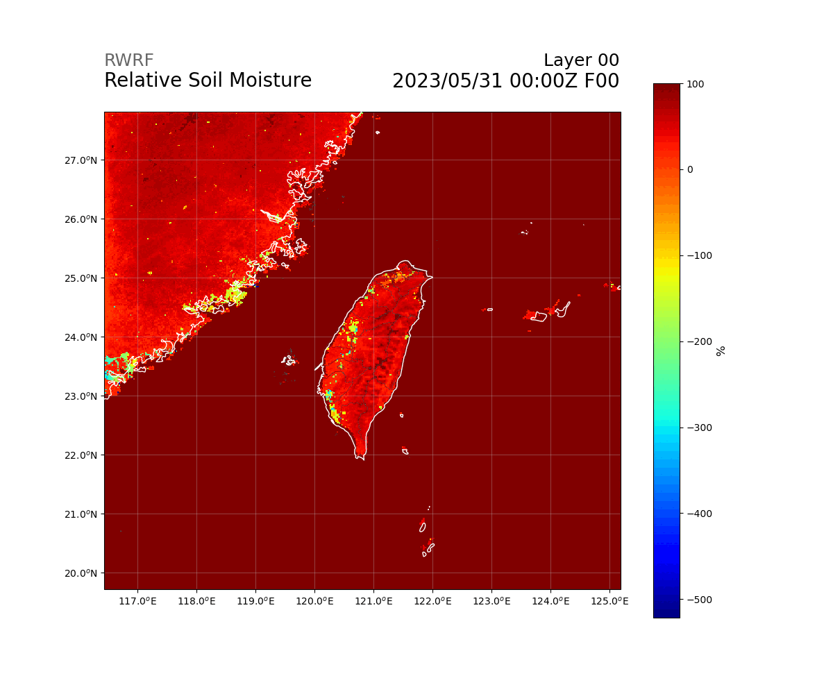

Variables (Soil)
float SH2O(Time, soil_layers_stag, south_north, west_east) ;
SH2O:FieldType = 104 ;
SH2O:MemoryOrder = "XYZ" ;
SH2O:description = "SOIL LIQUID WATER" ;
SH2O:units = "m3 m-3" ;
SH2O:stagger = "Z" ;
SH2O:coordinates = "XLONG XLAT XTIME" ;
float SMCREL(Time, soil_layers_stag, south_north, west_east) ;
SMCREL:FieldType = 104 ;
SMCREL:MemoryOrder = "XYZ" ;
SMCREL:description = "RELATIVE SOIL MOISTURE" ;
SMCREL:units = "" ;
SMCREL:stagger = "Z" ;
SMCREL:coordinates = "XLONG XLAT XTIME" ;

Slide 54
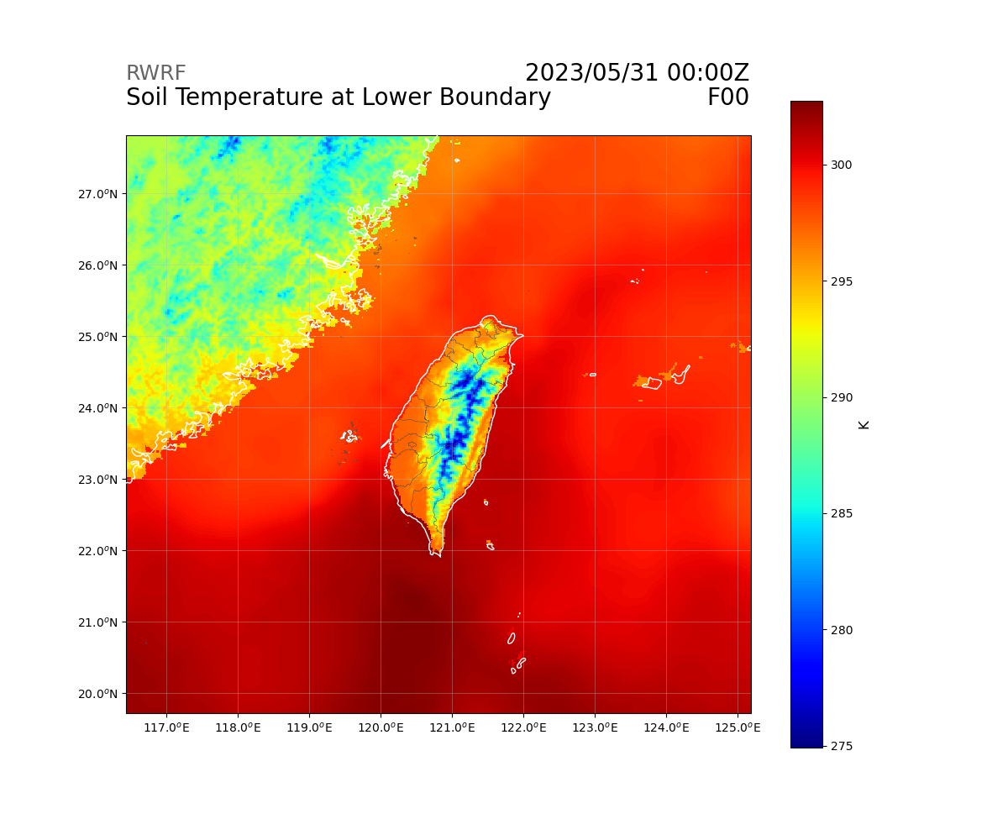
Variables (Soil)
float TMN(Time, south_north, west_east) ;
TMN:FieldType = 104 ;
TMN:MemoryOrder = "XY " ;
TMN:description = "SOIL TEMPERATURE AT LOWER BOUNDARY" ;
TMN:units = "K" ;
TMN:stagger = "" ;
TMN:coordinates = "XLONG XLAT XTIME" ;

Slide 55
Variables - Constant

Slide 56
Variables (SCM Ideal)
float HFX_FORCE(Time) ;
HFX_FORCE:FieldType = 104 ;
HFX_FORCE:MemoryOrder = "0 " ;
HFX_FORCE:description = "SCM ideal surface sensible heat flux" ;
HFX_FORCE:units = "W m-2" ;
HFX_FORCE:stagger = "" ;
float LH_FORCE(Time) ;
LH_FORCE:FieldType = 104 ;
LH_FORCE:MemoryOrder = "0 " ;
LH_FORCE:description = "SCM ideal surface latent heat flux" ;
LH_FORCE:units = "W m-2" ;
LH_FORCE:stagger = "" ;
float TSK_FORCE(Time) ;
TSK_FORCE:FieldType = 104 ;
TSK_FORCE:MemoryOrder = "0 " ;
TSK_FORCE:description = "SCM ideal surface skin temperature" ;
TSK_FORCE:units = "W m-2" ;
TSK_FORCE:stagger = "" ;

Slide 57
Variables (SCM Ideal)
float HFX_FORCE_TEND(Time) ;
HFX_FORCE_TEND:FieldType = 104 ;
HFX_FORCE_TEND:MemoryOrder = "0 " ;
HFX_FORCE_TEND:description = "SCM ideal surface sensible heat flux tendency" ;
HFX_FORCE_TEND:units = "W m-2 s-1" ;
HFX_FORCE_TEND:stagger = "" ;
float LH_FORCE_TEND(Time) ;
LH_FORCE_TEND:FieldType = 104 ;
LH_FORCE_TEND:MemoryOrder = "0 " ;
LH_FORCE_TEND:description = "SCM ideal surface latent heat flux tendency" ;
LH_FORCE_TEND:units = "W m-2 s-1" ;
LH_FORCE_TEND:stagger = "" ;
float TSK_FORCE_TEND(Time) ;
TSK_FORCE_TEND:FieldType = 104 ;
TSK_FORCE_TEND:MemoryOrder = "0 " ;
TSK_FORCE_TEND:description = "SCM ideal surface skin temperature tendency" ;
TSK_FORCE_TEND:units = "W m-2 s-1" ;
TSK_FORCE_TEND:stagger = "" ;

Slide 58
Variables (Constants)
float CFN(Time) ;
CFN:FieldType = 104 ;
CFN:MemoryOrder = "0 " ;
CFN:description = "extrapolation constant" ;
CFN:units = "" ;
CFN:stagger = "" ;
float CFN1(Time) ;
CFN1:FieldType = 104 ;
CFN1:MemoryOrder = "0 " ;
CFN1:description = "extrapolation constant" ;
CFN1:units = "" ;
CFN1:stagger = "" ;

Slide 59
Variables (Constants)
int THIS_IS_AN_IDEAL_RUN(Time) ;
THIS_IS_AN_IDEAL_RUN:FieldType = 106 ;
THIS_IS_AN_IDEAL_RUN:MemoryOrder = "0 " ;
THIS_IS_AN_IDEAL_RUN:description = "T/F flag: this is an ARW ideal simulation" ;
THIS_IS_AN_IDEAL_RUN:units = "-" ;
THIS_IS_AN_IDEAL_RUN:stagger = "" ;
int SAVE_TOPO_FROM_REAL(Time) ;
SAVE_TOPO_FROM_REAL:FieldType = 106 ;
SAVE_TOPO_FROM_REAL:MemoryOrder = "0 " ;
SAVE_TOPO_FROM_REAL:description = "1=original topo from real/0=topo modified by WRF" ;
SAVE_TOPO_FROM_REAL:units = "flag" ;
SAVE_TOPO_FROM_REAL:stagger = "" ;

Slide 60
Variables (Constants)
float CF1(Time) ;
CF1:FieldType = 104 ;
CF1:MemoryOrder = "0 " ;
CF1:description = "2nd order extrapolation constant" ;
CF1:units = "" ;
CF1:stagger = "" ;
float CF2(Time) ;
CF2:FieldType = 104 ;
CF2:MemoryOrder = "0 " ;
CF2:description = "2nd order extrapolation constant" ;
CF2:units = "" ;
CF2:stagger = "" ;
float CF3(Time) ;
CF3:FieldType = 104 ;
CF3:MemoryOrder = "0 " ;
CF3:description = "2nd order extrapolation constant" ;
CF3:units = "" ;
CF3:stagger = "" ;

Slide 61
Variables (Constants)
int ITIMESTEP(Time) ;
ITIMESTEP:FieldType = 106 ;
ITIMESTEP:MemoryOrder = "0 " ;
ITIMESTEP:description = "" ;
ITIMESTEP:units = "" ;
ITIMESTEP:stagger = "" ;
float XTIME(Time) ;
XTIME:FieldType = 104 ;
XTIME:MemoryOrder = "0 " ;
XTIME:description = "minutes since 2023-05-31 00:00:00" ;
XTIME:units = "minutes since 2023-05-31 00:00:00" ;
XTIME:stagger = "" ;

Slide 62
Variables (Base State)
float P_TOP(Time) ;
P_TOP:FieldType = 104 ;
P_TOP:MemoryOrder = "0 " ;
P_TOP:description = "PRESSURE TOP OF THE MODEL" ;
P_TOP:units = "Pa" ;
P_TOP:stagger = "" ;
float TLP(Time) ;
TLP:FieldType = 104 ;
TLP:MemoryOrder = "0 " ;
TLP:description = "BASE STATE LAPSE RATE" ;
TLP:units = "" ;
TLP:stagger = "" ;

Slide 63
Variables (Base State)
float T00(Time) ;
T00:FieldType = 104 ;
T00:MemoryOrder = "0 " ;
T00:description = "BASE STATE TEMPERATURE" ;
T00:units = "K" ;
T00:stagger = "" ;
float P00(Time) ;
P00:FieldType = 104 ;
P00:MemoryOrder = "0 " ;
P00:description = "BASE STATE PRESURE" ;
P00:units = "Pa" ;
P00:stagger = "" ;

Slide 64
Variables (Base State)
float TISO(Time) ;
TISO:FieldType = 104 ;
TISO:MemoryOrder = "0 " ;
TISO:description = "TEMP AT WHICH THE BASE T TURNS CONST" ;
TISO:units = "K" ;
TISO:stagger = "" ;

Slide 65
Variables (Base State)
float TLP_STRAT(Time) ;
TLP_STRAT:FieldType = 104 ;
TLP_STRAT:MemoryOrder = "0 " ;
TLP_STRAT:description = "BASE STATE LAPSE RATE (DT/D(LN(P)) IN STRATOSPHERE" ;
TLP_STRAT:units = "K" ;
TLP_STRAT:stagger = "" ;
float P_STRAT(Time) ;
P_STRAT:FieldType = 104 ;
P_STRAT:MemoryOrder = "0 " ;
P_STRAT:description = "BASE STATE PRESSURE AT BOTTOM OF STRATOSPHERE" ;
P_STRAT:units = "Pa" ;
P_STRAT:stagger = "" ;

Slide 66
Global Attributes

Slide 67
Global Attributes - Title
TITLE = " OUTPUT FROM WRF V3.8.1 MODEL" ;
START_DATE = "2023-05-31_00:00:00" ;
SIMULATION_START_DATE = "2023-05-31_00:00:00" ;
WEST-EAST_GRID_DIMENSION = 451 ;
SOUTH-NORTH_GRID_DIMENSION = 451 ;
BOTTOM-TOP_GRID_DIMENSION = 52 ;
DX = 2000.f ; // Units: m
DY = 2000.f ; // Units: m
CEN_LAT = 23.7644f ;
CEN_LON = 120.814f ;

Slide 68
Global Attributes - Time
GMT = 0.f ;
JULYR = 2023 ;
JULDAY = 151 ;

Slide 69
Global Attributes – Map Setting
GRID_ID = 1 ;
PARENT_ID = 0 ;
I_PARENT_START = 0 ;
J_PARENT_START = 0 ;
PARENT_GRID_RATIO = 1 ;

Slide 70
Global Attributes – Map Setting
TRUELAT1 = 10.f ;
TRUELAT2 = 40.f ;
MOAD_CEN_LAT = 21.49418f ;
STAND_LON = 120.f ;
POLE_LAT = 90.f ;
POLE_LON = 0.f ;
MAP_PROJ = 1 ;
MAP_PROJ_CHAR = "Lambert Conformal" ;
MMINLU = "MODIFIED_IGBP_MODIS_NOAH" ;
NUM_LAND_CAT = 20 ;

Slide 71
Global Attributes - Map Setting
ISWATER = 17 ;
ISLAKE = -1 ;
ISICE = 15 ;
ISURBAN = 13 ;
ISOILWATER = 14 ;

Slide 72
Global Attributes - Map Setting
WEST-EAST_PATCH_START_UNSTAG = 1 ;
WEST-EAST_PATCH_END_UNSTAG = 450 ;
WEST-EAST_PATCH_START_STAG = 1 ;
WEST-EAST_PATCH_END_STAG = 451 ;
SOUTH-NORTH_PATCH_START_UNSTAG = 1 ;
SOUTH-NORTH_PATCH_END_UNSTAG = 450 ;
SOUTH-NORTH_PATCH_START_STAG = 1 ;
SOUTH-NORTH_PATCH_END_STAG = 451 ;
BOTTOM-TOP_PATCH_START_UNSTAG = 1 ;
BOTTOM-TOP_PATCH_END_UNSTAG = 51 ;
BOTTOM-TOP_PATCH_START_STAG = 1 ;
BOTTOM-TOP_PATCH_END_STAG = 52 ;

Slide 73
Global Attributes
SKEBS_ON = 0 ;
SPEC_BDY_FINAL_MU = 1 ;
USE_Q_DIABATIC = 0 ;
GRIDTYPE = "C" ;
DIFF_OPT = 1 ;
KM_OPT = 4 ;
DAMP_OPT = 3 ;
DAMPCOEF = 0.2f ;
KHDIF = 0.f ;
KVDIF = 0.f ;

Slide 74
Global Attributes
MP_PHYSICS = 7 ;
RA_LW_PHYSICS = 4 ;
RA_SW_PHYSICS = 4 ;
SF_SFCLAY_PHYSICS = 91 ;
SF_SURFACE_PHYSICS = 2 ;
BL_PBL_PHYSICS = 1 ;
CU_PHYSICS = 0 ;
SF_LAKE_PHYSICS = 0 ;
SURFACE_INPUT_SOURCE = 1 ;
SST_UPDATE = 0 ;

Slide 75
Global Attributes
GRID_FDDA = 0 ;
GFDDA_INTERVAL_M = 0 ;
GFDDA_END_H = 0 ;
GRID_SFDDA = 0 ;
SGFDDA_INTERVAL_M = 0 ;
SGFDDA_END_H = 0 ;
HYPSOMETRIC_OPT = 2 ;
USE_THETA_M = 0 ;
SF_URBAN_PHYSICS = 0 ;
SHCU_PHYSICS = 0 ;

Slide 76
Global Attributes
MFSHCONV = 0 ;
FEEDBACK = 0 ;
SMOOTH_OPTION = 0 ;
SWRAD_SCAT = 1.f ;
W_DAMPING = 1 ;
DT = 6.f ;
RADT = 30.f ;
BLDT = 0.f ;
CUDT = 0.f ;
AER_OPT = 0 ;
SWINT_OPT = 1 ;

Slide 77
Global Attributes
AER_TYPE = 1 ;
AER_AOD550_OPT = 1 ;
AER_ANGEXP_OPT = 1 ;
AER_SSA_OPT = 1 ;
AER_ASY_OPT = 1 ;
AER_AOD550_VAL = 0.12f ;
AER_ANGEXP_VAL = 1.3f ;
AER_SSA_VAL = 1.401298e-45f ;
AER_ASY_VAL = 1.401298e-45f ;

Slide 78
Global Attributes
MOIST_ADV_OPT = 1 ;
SCALAR_ADV_OPT = 0 ;
TKE_ADV_OPT = 1 ;
DIFF_6TH_OPT = 0 ;
DIFF_6TH_FACTOR = 0.12f ;
OBS_NUDGE_OPT = 0 ;
BUCKET_MM = -1.f ;
BUCKET_J = -1.f ;
PREC_ACC_DT = 0.f ;
SF_OCEAN_PHYSICS = 0 ;

Slide 79
Global Attributes
ISFTCFLX = 0 ;
ISHALLOW = 0 ;
ISFFLX = 1 ;
ICLOUD = 1 ;
ICLOUD_CU = 0 ;
TRACER_PBLMIX = 1 ;
SCALAR_PBLMIX = 0 ;
YSU_TOPDOWN_PBLMIX = 1 ;
GRAV_SETTLING = 0 ;
DFI_OPT = 0 ;
SIMULATION_INITIALIZATION_TYPE = "REAL-DATA CASE" ;

